Slide 1
2.0 Resonance, Coupled Circuits and Dependant Sources
EE1203 – Theory of Electricity
Prof J. Rohan Lucas
lucas@kdu.ac.lk
Department of Electrical, Electronic & Telecommunication Engineering
General Sir John Kotelawala Defence University
December 2021
Notes:
Today, you will listen to my recorded presentation on the topic “Resonance, Coupled Circuits and Dependant Sources” in the module Theory of Electricity.
This is an examinable module, and this lecture will be considered as part of the delivered lectures for the module.
I will try and record this module to be as close as possible to a live lecture in the classroom. However, you will not be able to ask online questions “but” get clarifications from me by an email.

Slide 2
Learning Outcomes
On completion of module, student will be able to
LO1: Analyse the performances of AC circuits
Analyse circuits using nodal and mesh theory
LO2: Analyse two port networks using different models.
LO3: Analyse transfer functions of RLC networks for transients.
LO4: Analyse waveforms for its harmonics.
LO5: Perform calculations in three phase circuits including unbalanced waveforms.
t
Notes:
.

Slide 3
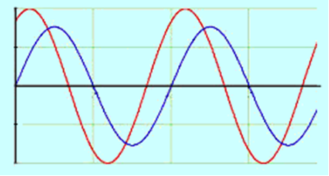
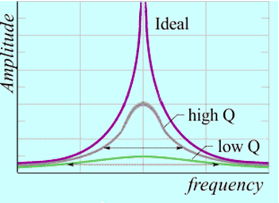
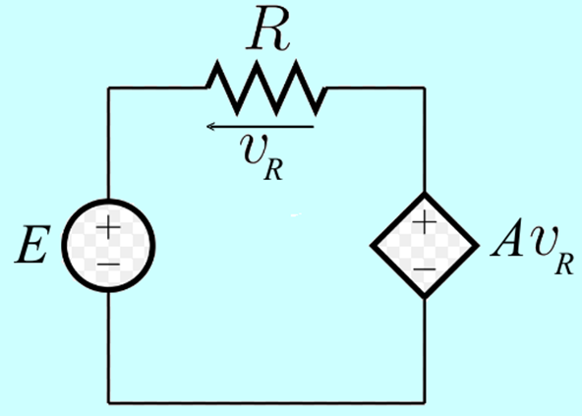
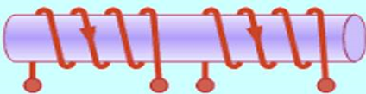
AC Circuit analysis (9 hrs)
Review of basic components and AC theory Series and parallel resonance Electromagnetic coupling: Mutual inductance, Analysis of coupled circuits, Transformer. Dependent sources: solving circuits
t
Notes:
.

Slide 4
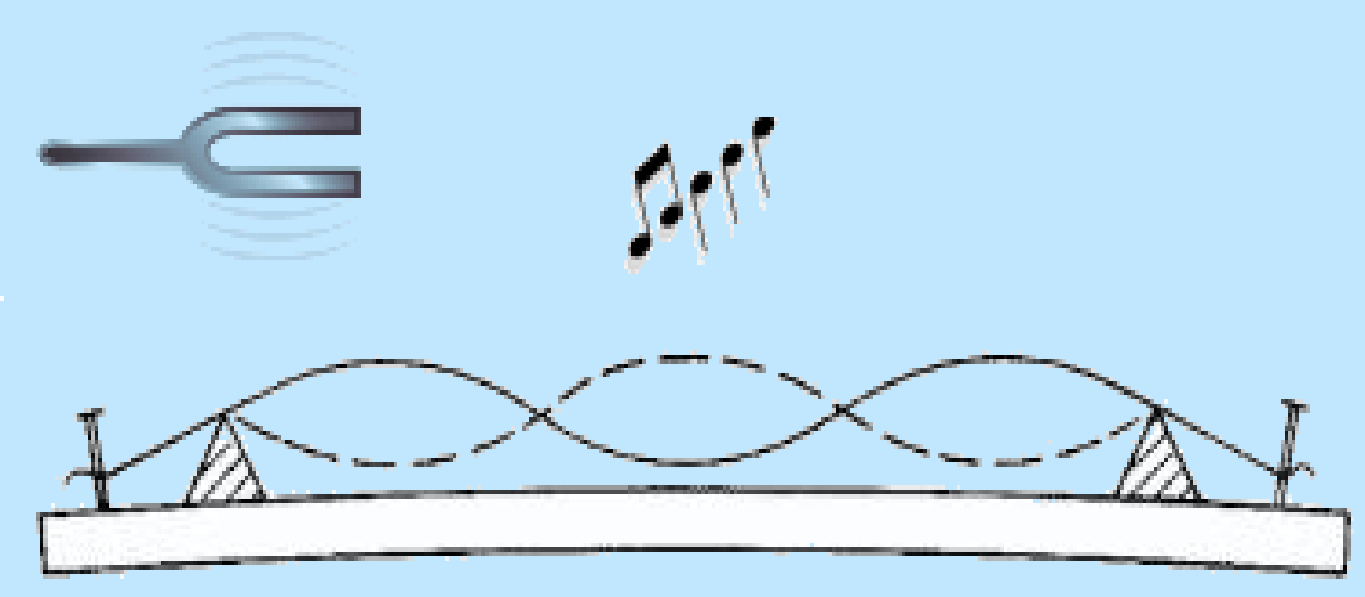
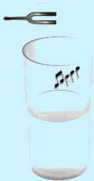
Resonance
At resonance (in sound)
maximum vibration (string) and hear the
greatest sound (water column)
Same idea is present in electrical engineering.
Resonance basically occurs when a quantity, such as voltage or current, becomes a maximum.
Maximum one quantity → minimum with another
So that resonance could occur at a minimum value of a quantity as well

Slide 5
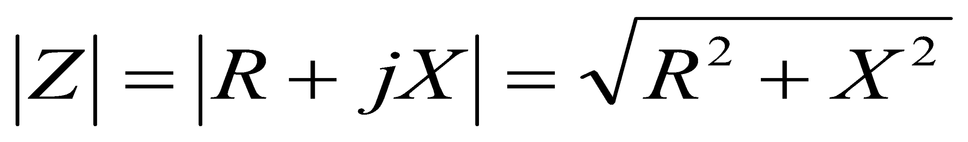
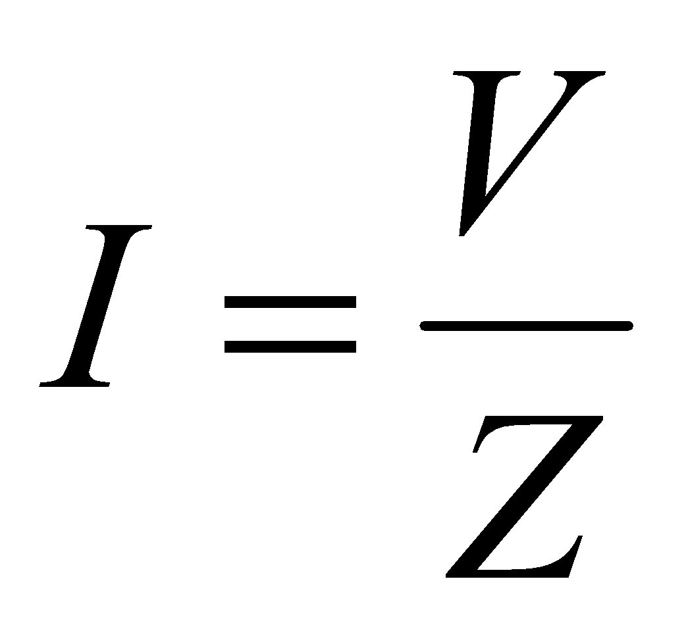
Resonance in an Electrical Circuit
R L C
For a given source voltage,
current would be maximum when
impedance of the circuit is a minimum
In an a.c. circuit
would have a minimum value when X is zero
(Possible because inductive and capacitive reactances have opposite signs).
Thus current becomes a maximum, or resonance

Slide 6
Methods of defining Electrical Resonance
When X is zero, the circuit is purely resistive
Impedance Z becomes a minimum
  Voltage for given current becomes a minimum
  Current for given voltage becomes a maximum
Impedance angle becomes zero
  power factor of the circuit becomes unity.
When B is zero, the circuit is purely resistive
Admittance becomes a minimum
  Voltage for given current becomes a maximum
  Current for given voltage becomes a minimum
Admittance angle becomes zero
  power factor of the circuit becomes unity.

Slide 7
Series Resonance
Current through a circuit for a given source voltage becomes a maximum:
voltage across a circuit for a given source current becomes a minimum,
admittance of the circuit becomes a maximum, or
impedance of the circuit becomes a minimum.

Slide 8
Parallel Resonance
voltage across a circuit for a given source current becomes a maximum:
current through a circuit for a given source voltage becomes a minimum,
impedance of the circuit becomes a maximum, or
admittance of the circuit becomes a minimum.

Slide 9
Unity Power Factor Resonance
Power Factor of the circuit becomes Unity:
when the impedance of the circuit is purely real
  when the impedance angle is zero,
when the admittance of the circuit is purely real
  when the admittance angle is zero,
when the voltage and the current are in phase.
Unity power factor condition could correspond to either series resonance or parallel resonance.
In complex circuits, unity power factor condition could give displaced answers from the other two.

Slide 10
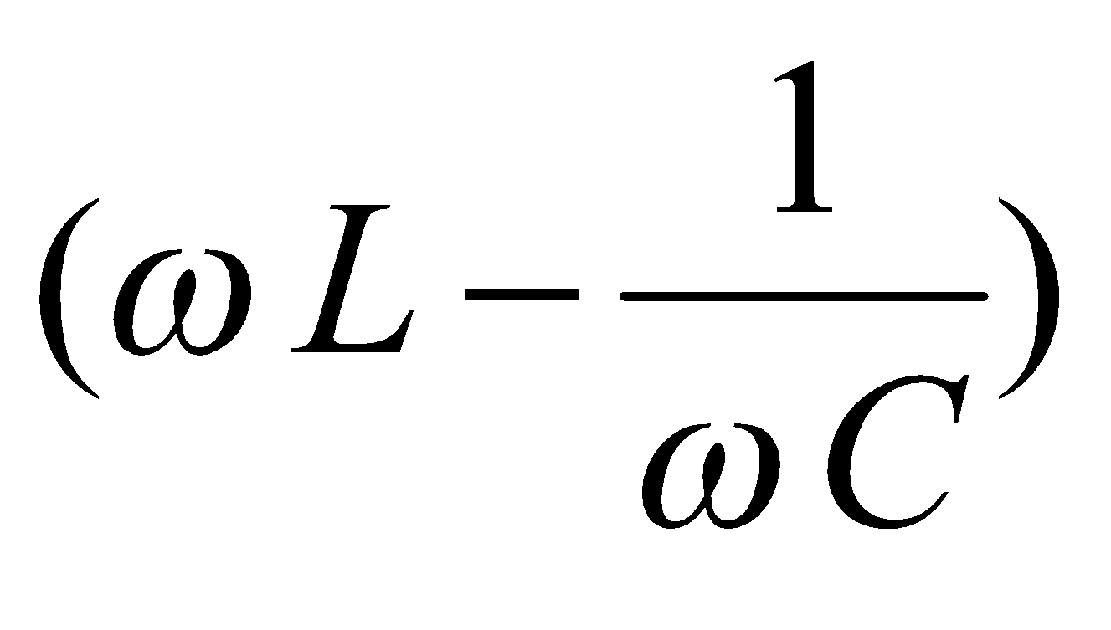
Unity power factor resonance for series circuit
Consider frequency at which power factor becomes unity.
Occurs when imaginary-part(impedance) → 0
or imaginary-part(current) → 0. i.e. j = 0,
or at ω = ω_{o}. (same as before).
Shape of curve is dependant on value of r of the circuit.
As r → 0, perfect resonance occurs, I → ∞ at ω = ω_{o}
As r → 0, angle of current with respect to voltage tends to either π/2 or -π/2, changing at ω = ω_{o}.
Series resistance r defines quality of the resonance.
If r is low, P_{loss} is low and hence the quality is high.
At resonance, low r means r << Lω_{o} and r << 1/Cω_{o}.

Slide 11
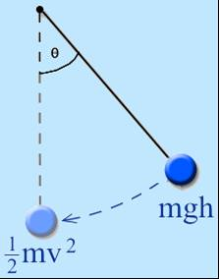
Conditions for Oscillations to occur
What determines natural frequency of oscillations ?
Consider the simple pendulum. Why does it oscillate ?
Because of stored energy in the system
– potential energy and kinetic energy.
During oscillations, energy transfers between potential energy and kinetic energy.
Natural frequency of oscillations, depends on the value of gravity, length and so on.
Friction in the medium would reduce the energy and cause the pendulum to slow down and finally stop.

Slide 12
Resonance in an Electric Circuit
Energy is stored in the
electrostatic field in the capacitance
electromagnetic field in the inductance.
Oscillations occur when the energy gets transferred between these two forms.
Resistance would cause energy losses
results decreasing magnitude of oscillations.

Slide 13
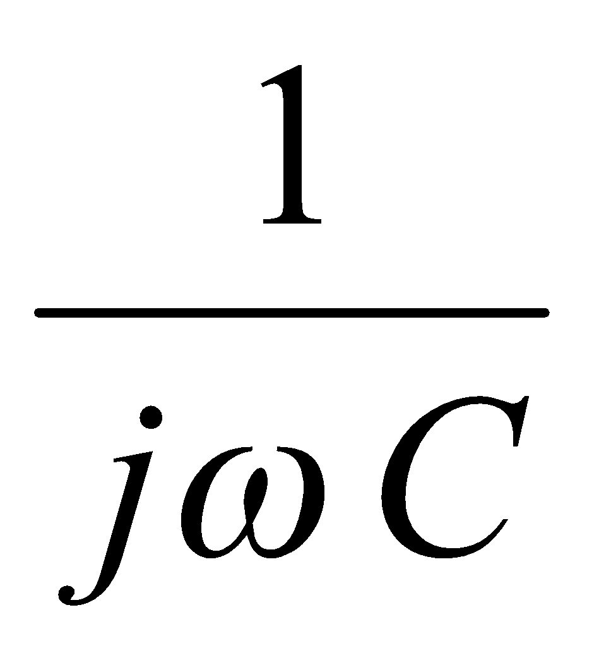
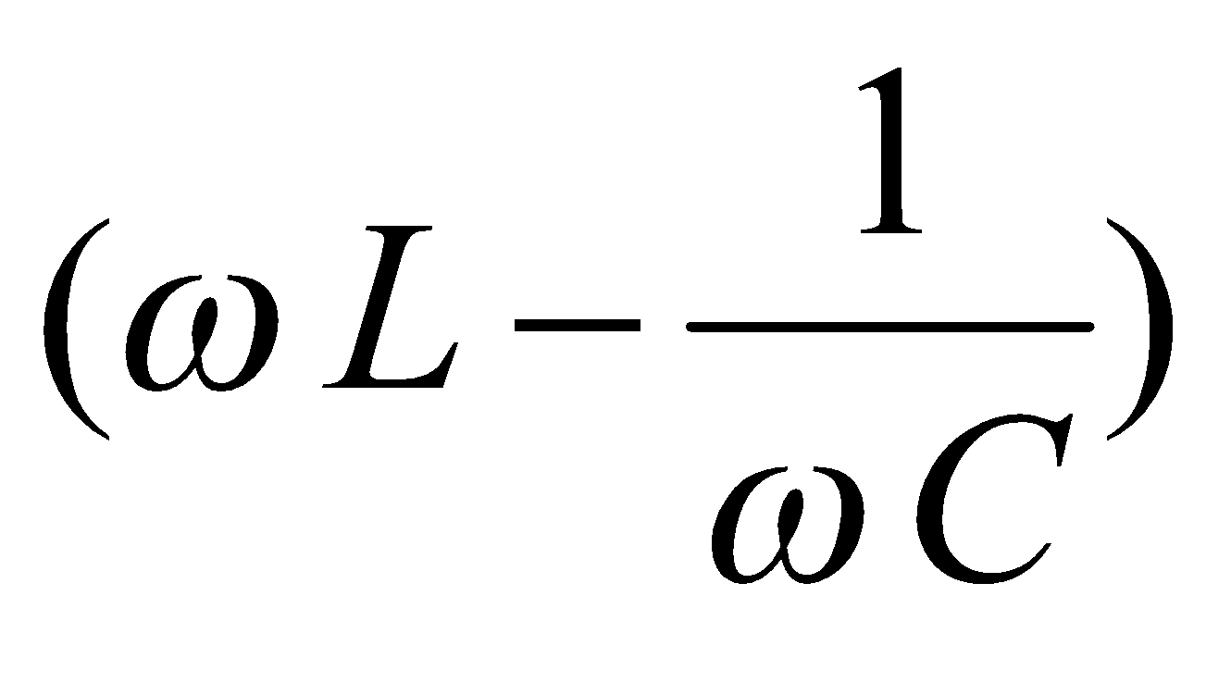
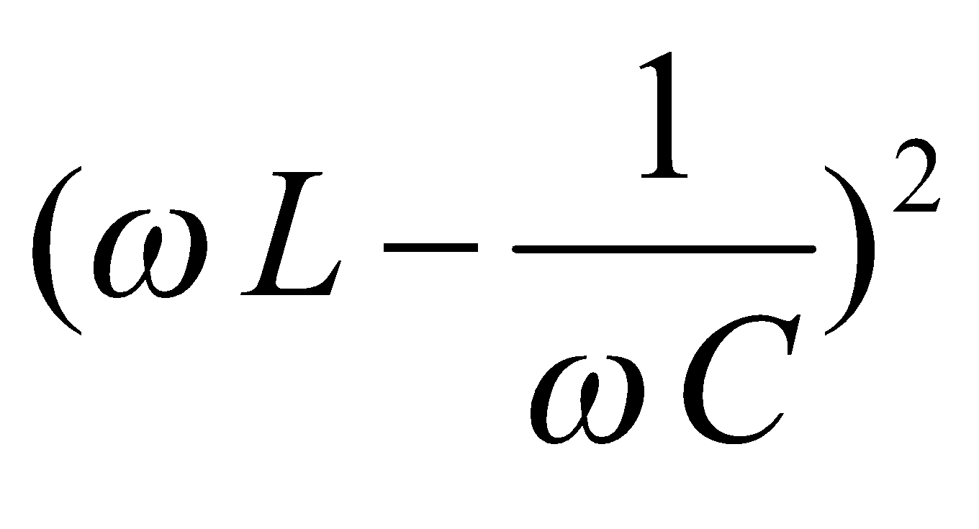
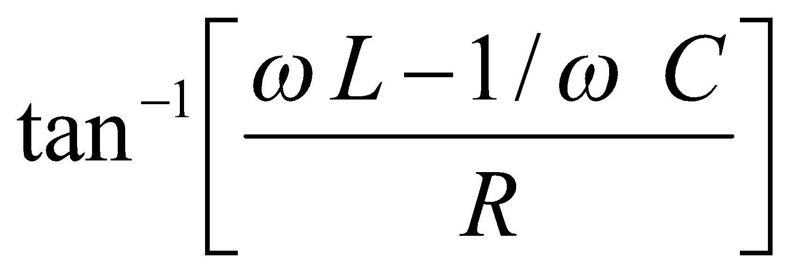
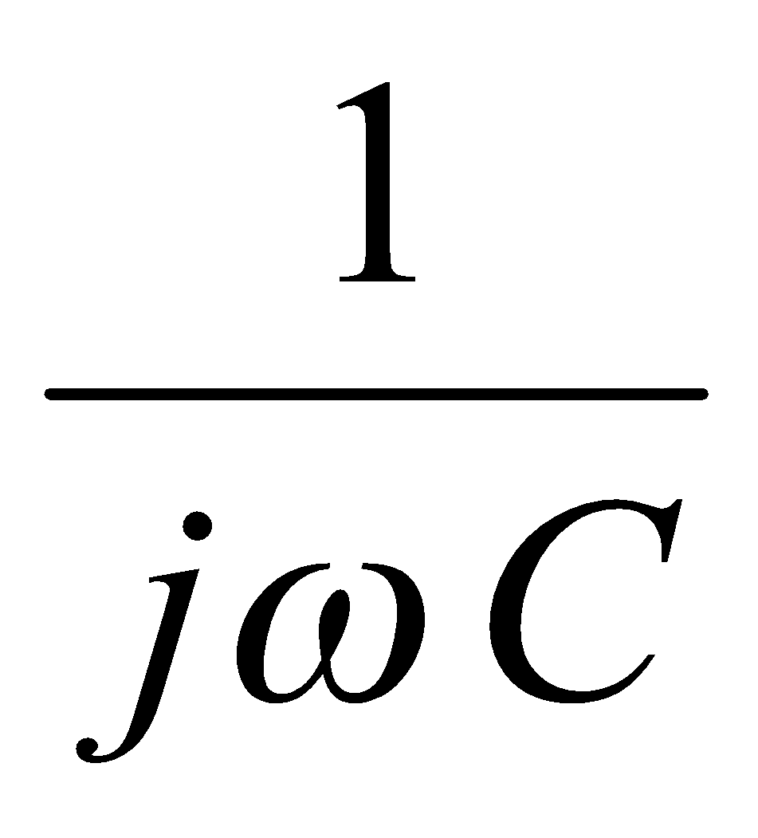
Series Resonance
R
jωL
Occurs in a circuit where the energy storage elements are in series.
At angular frequency of w,
Z = R + jwL + = R + j
Consider value of w when | I | becomes a maximum for a given V → | Z | becoming a minimum,
or | V| becoming a minimum for a given I.
magnitude of impedance = | Z |, | Z |² = R² +
phase angle of Z, θ =

Slide 14
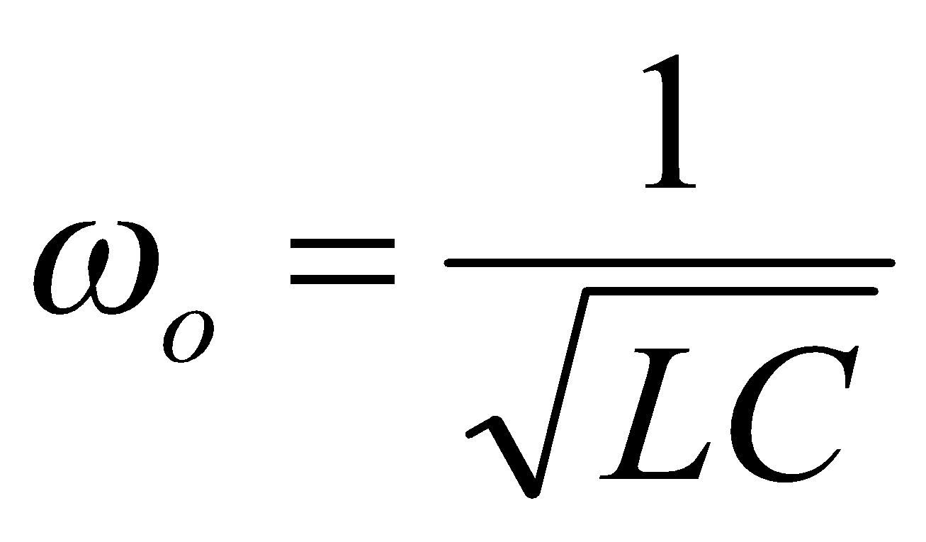
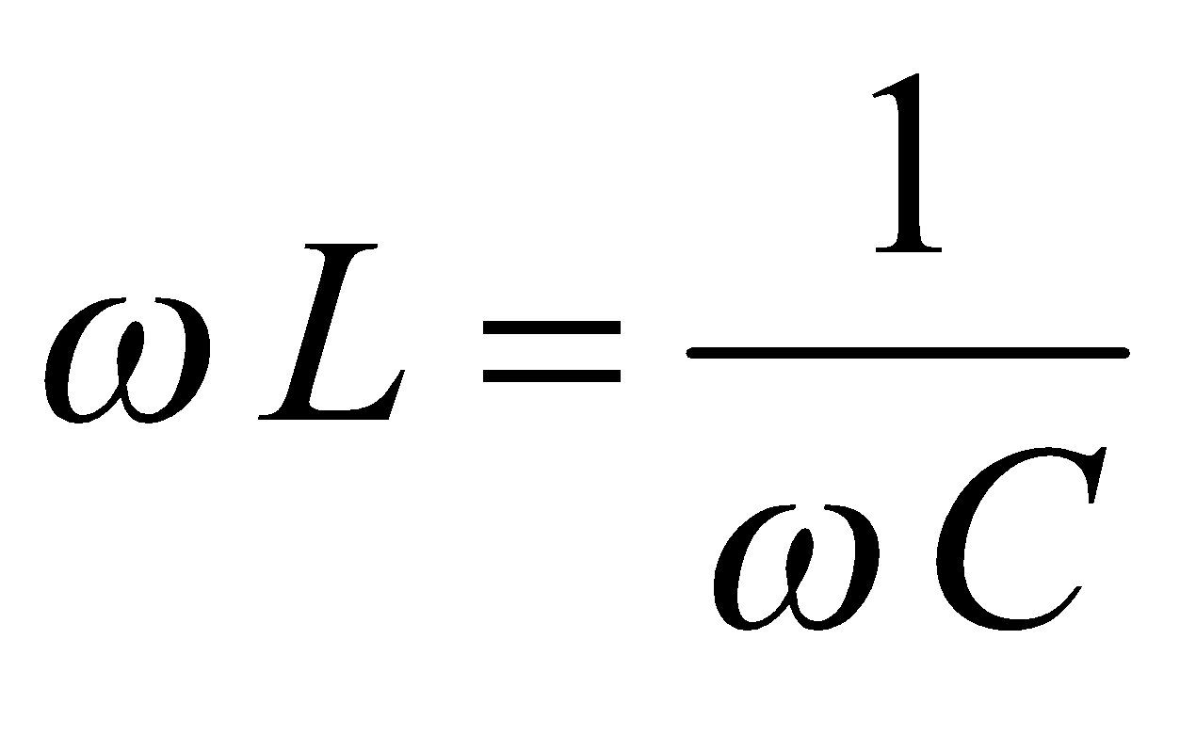
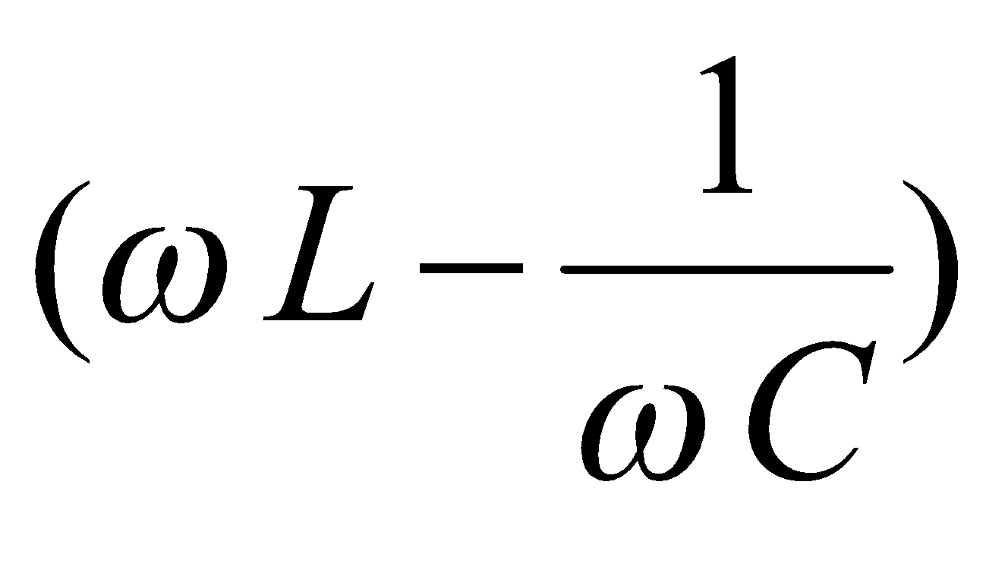
Determination of Maximum/Minimum of | Z |
differentiation of | Z | or
differentiation of even | Z |² or
inspection from physical considerations.
Since | Z |² consists of the sum of two square terms, the minimum value for any of components would be zero.
Since only the second term is dependant on ω, the minimum value could occur when second term is zero.
i.e. for minimum value of | Z |² , = 0
or or
This would also correspond to the minimum value of Z.

Slide 15
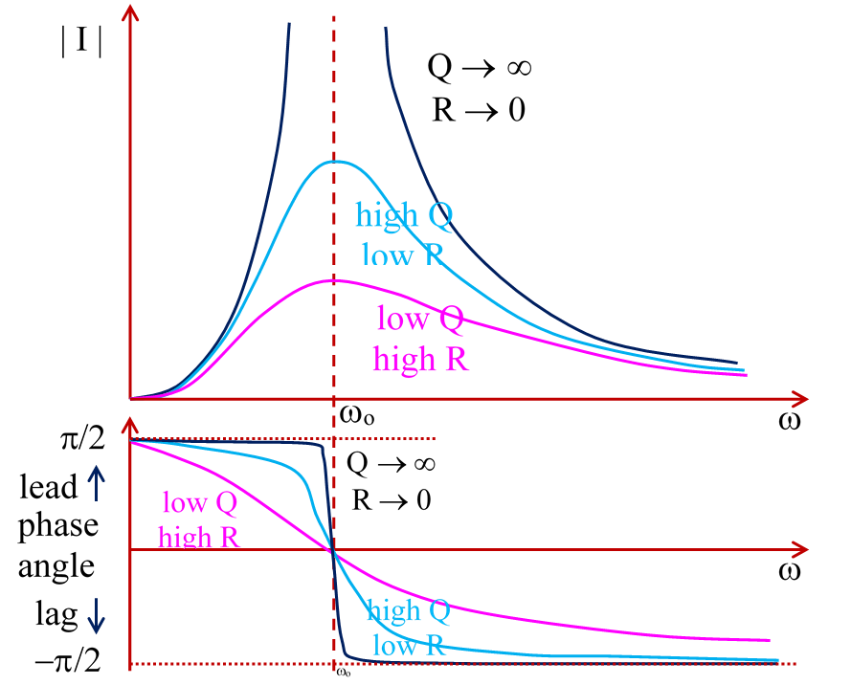
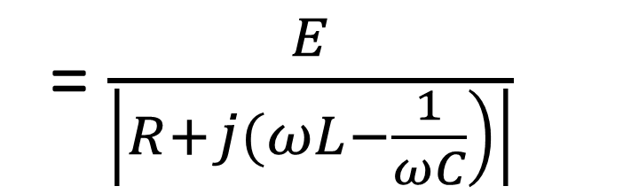
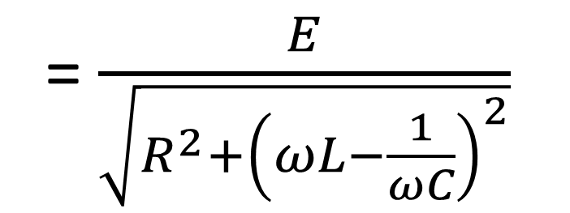
Resonance Curves
| I |

Slide 16
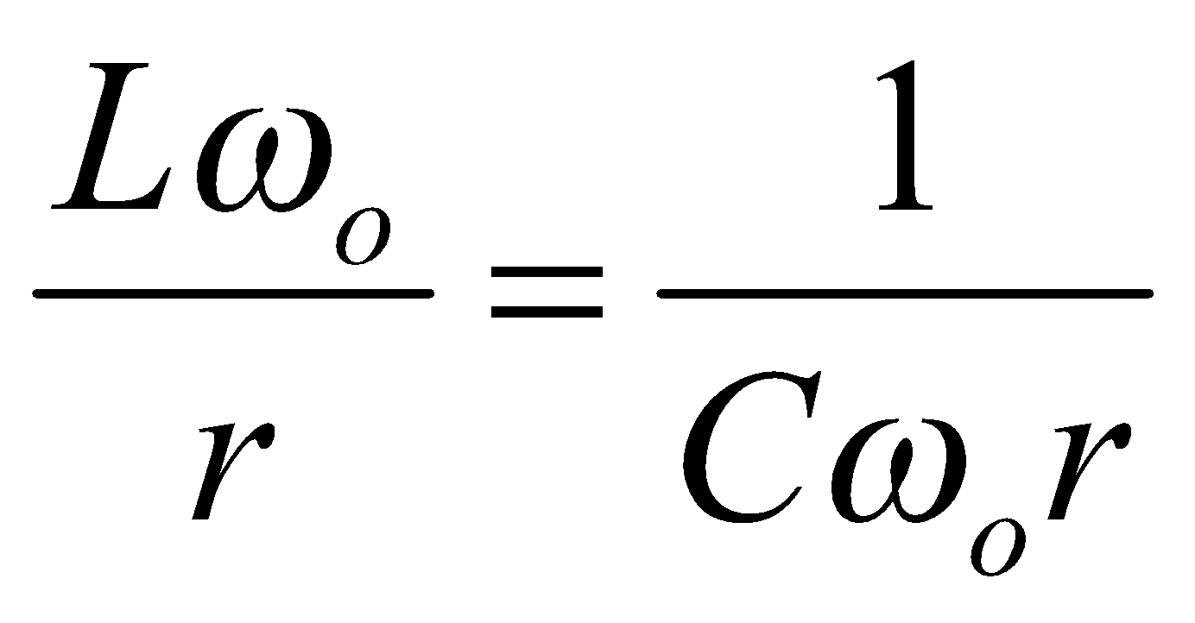
Quality of a Circuit Component
Originally, the quality of an inductance L or Capacitance C was defined as a comparison of Lω_{o} to r or 1/Cω_{o} to r.
Quality = at resonance, for a series circuit
[For a parallel circuit, quality would actually increase when value of resistance R → ∞ rather R → 0, and hence inverse ratio would define the quality]
This means of defining quality of a resonant circuit
would appear to cause confusing results if the
series and parallel circuits are considered.

Slide 17
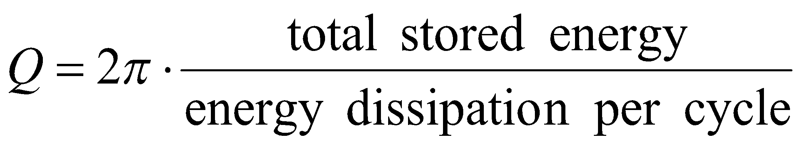
Quality Factor Q
Necessary to have a unique definition
in terms of quantities which do not vary with circuit.
Quality of resonant circuit is thus defined as the relationship between
maximum energy stored in energy storing elements (L or C) and
energy dissipation in resistive elements in the circuit.
For consistency with original definitions, Q factor has a multiplying constant 2π, in addition to ratio of energies.

Slide 18
Total stored energy in Electrical Circuit
maximum energy stored in electromagnetic field (inductor) occurs when current is a maximum,
maximum energy stored in electrostatic field occurs (capacitor) when voltage is a maximum.
Total energy is constant unless dissipated by resistance.
Energy stored at either the peak current (½ L I_{m}²) or the peak voltage (½ C V_{m}²) is considered as these are the extremes.
For series circuit, it is easier to consider current through inductance rather than the voltage across the capacitor.

Slide 19
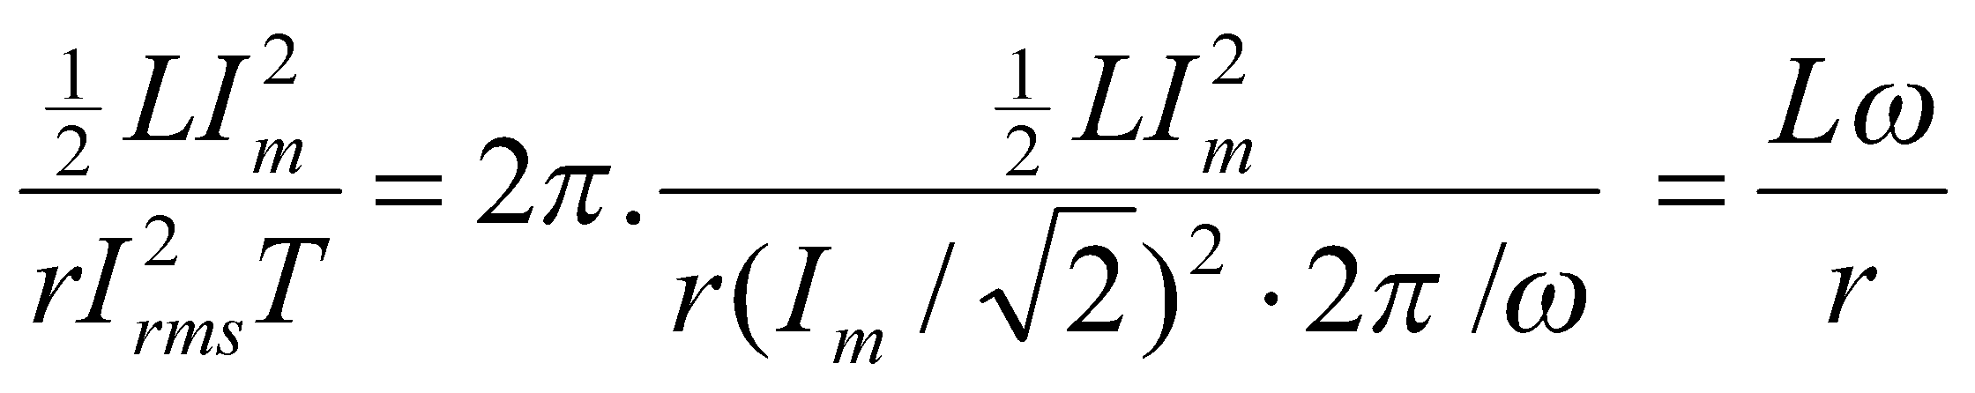
Comparison of Energy based and Impedance based formulae
For the series circuit,
for current i(t) = I_{m} sin ωt
Maximum energy stored in inductor = ½ L I_{m}²
Energy dissipated per cycle in series resistor = r I_{rms}² T
However T = 2π/ω, and
Q =
which is the expected result.
Similar verification can be done for parallel circuit.

Slide 20
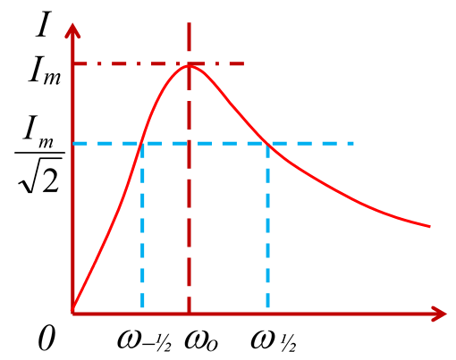

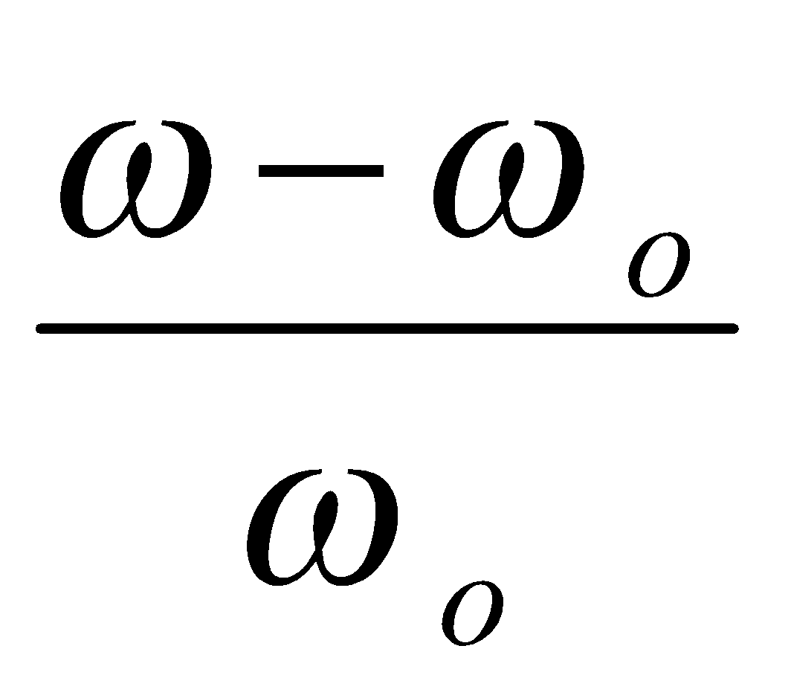
Relationship between Q-factor and bandwidth
P_{max} occurs at I_{max} (or V_{max}) at resonance frequency w_{o}.
Since P ∝ I² (or V²), half-power occurs when I (or V) decreases by √2.
ω_{−½} and ω _{½} are half power points.
Bandwidth = frequency range between half power points = ω _{½} − ω_{−½}
Fractional deviation of frequency from resonance δ =

Slide 21
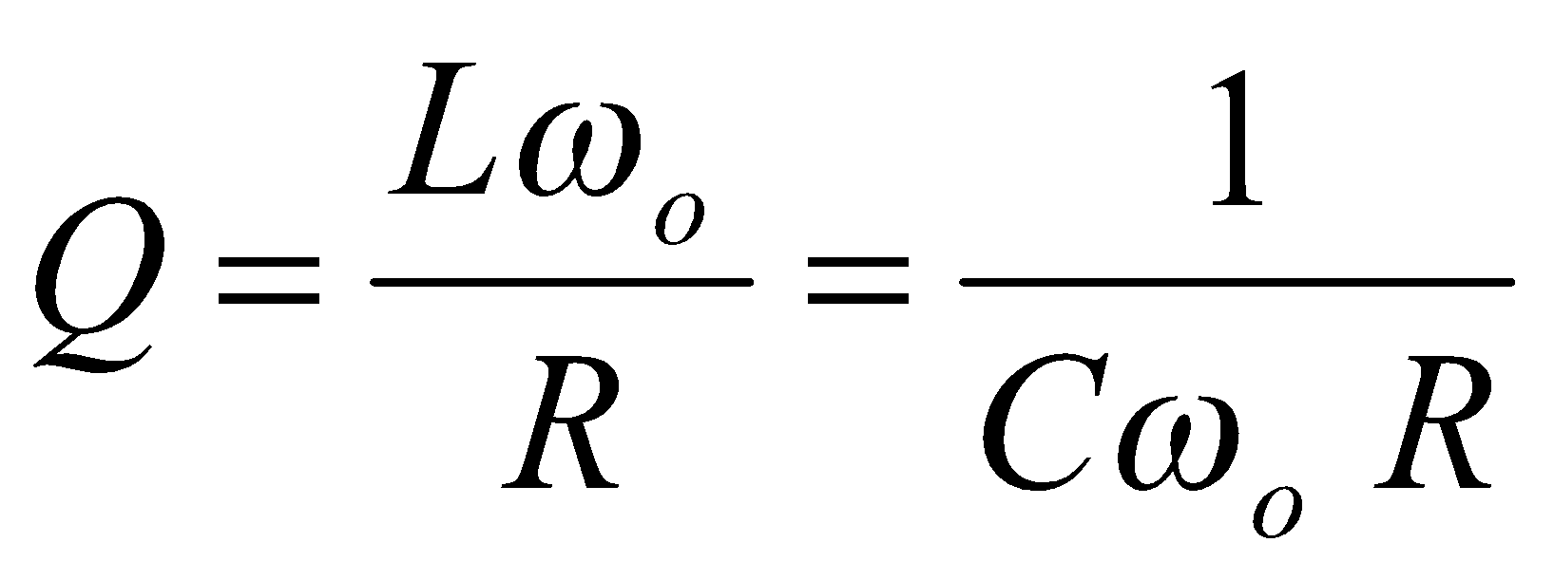
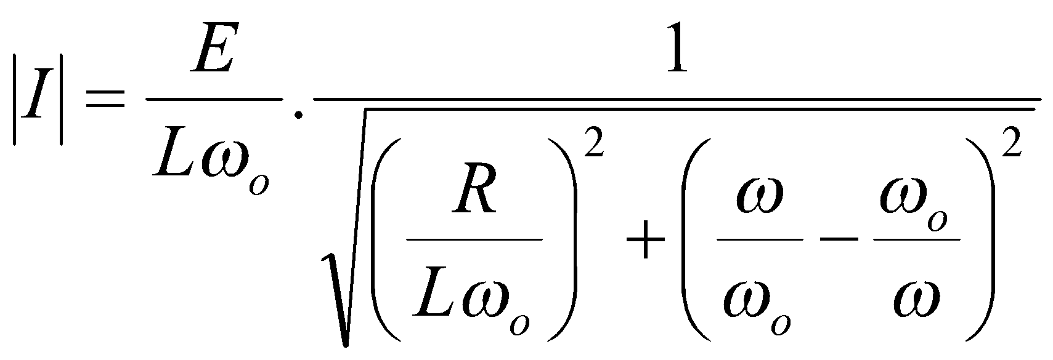
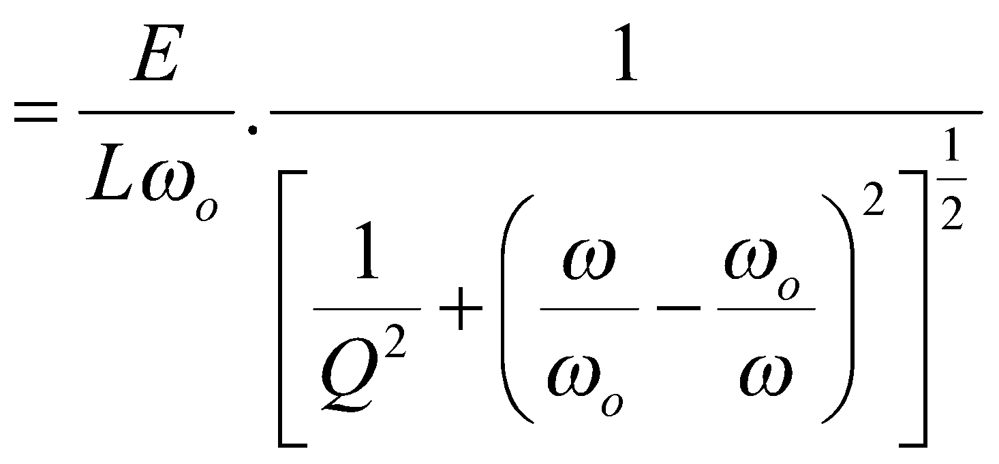
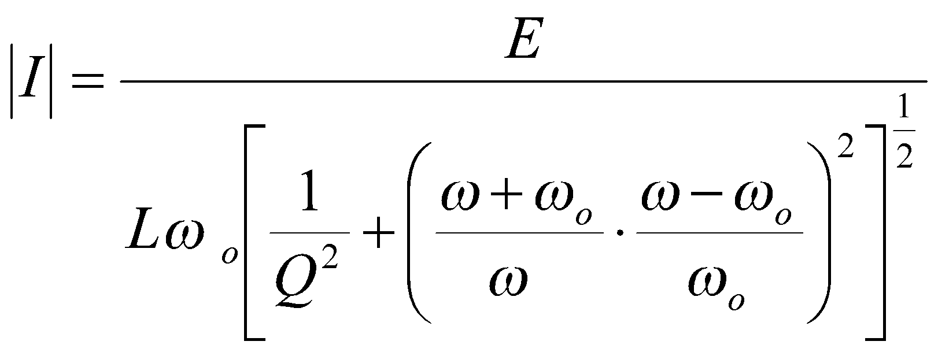
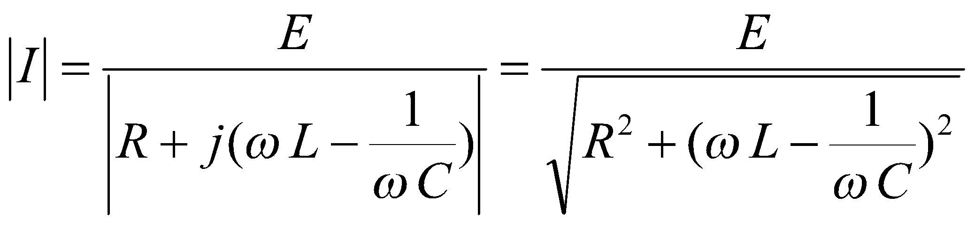
Proof for series RLC circuit
R
jωL
and
so that

Slide 22
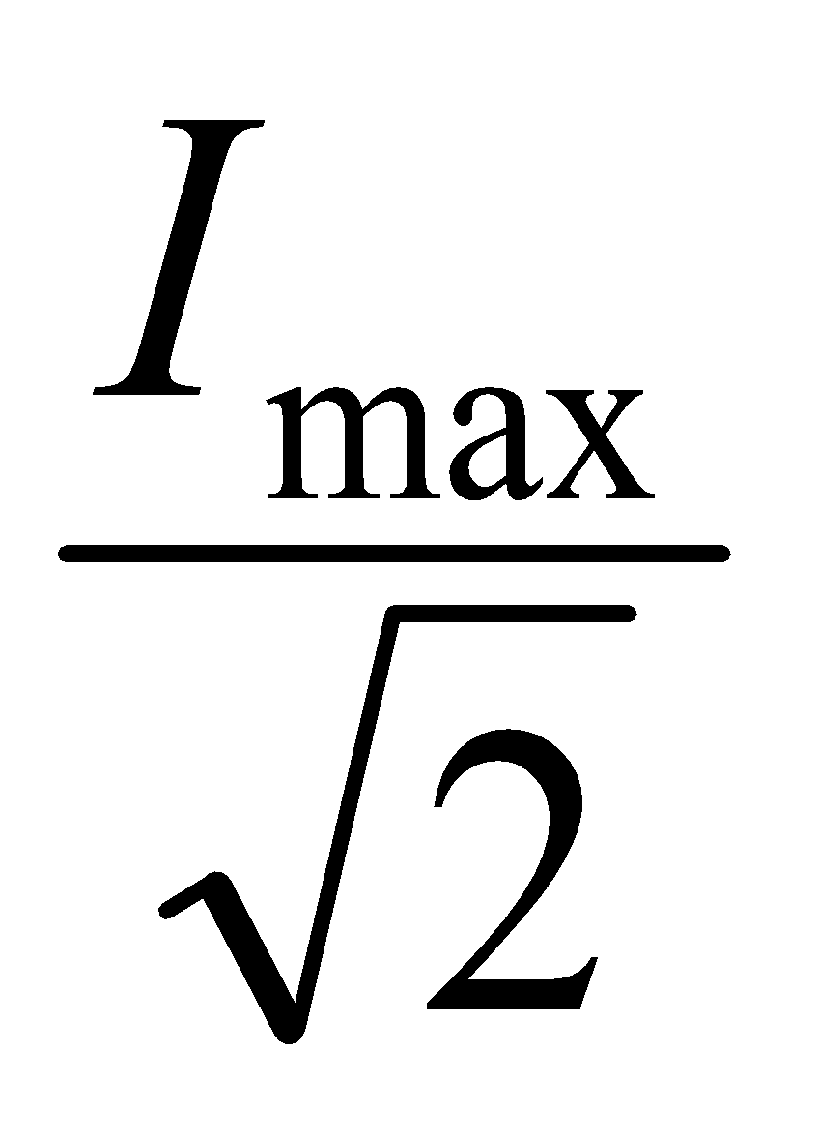
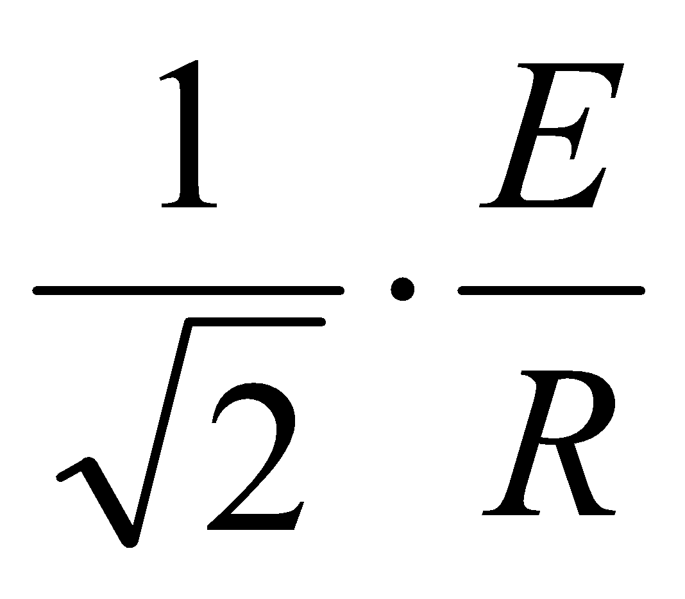
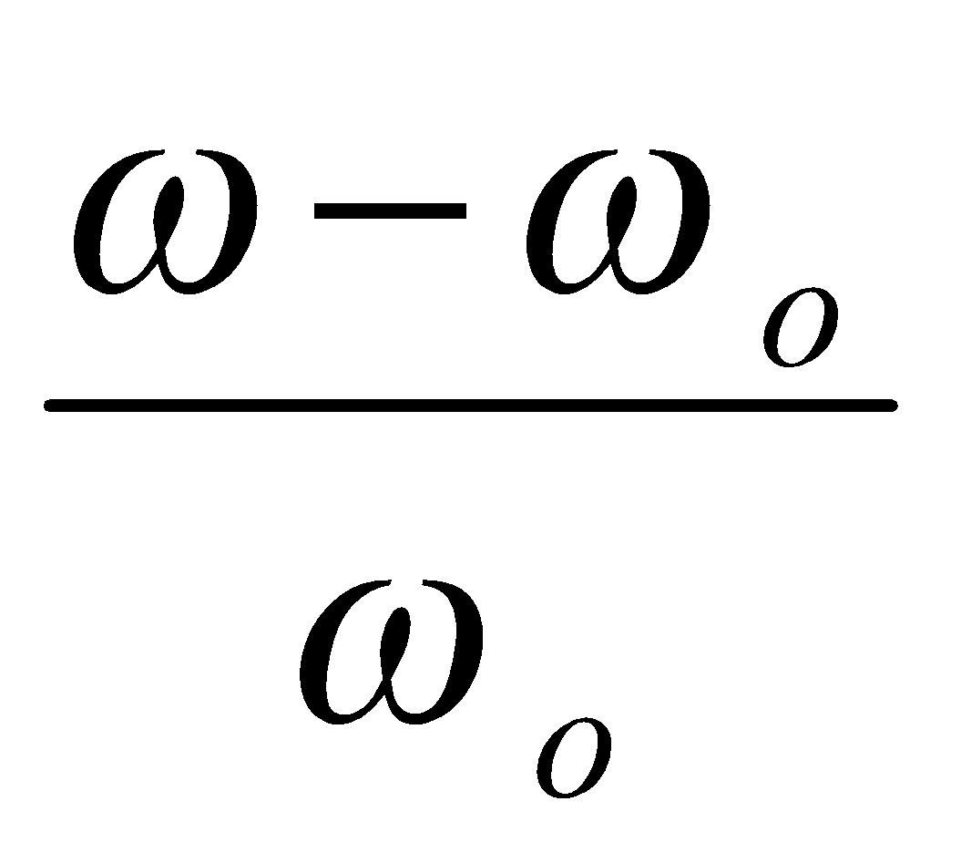
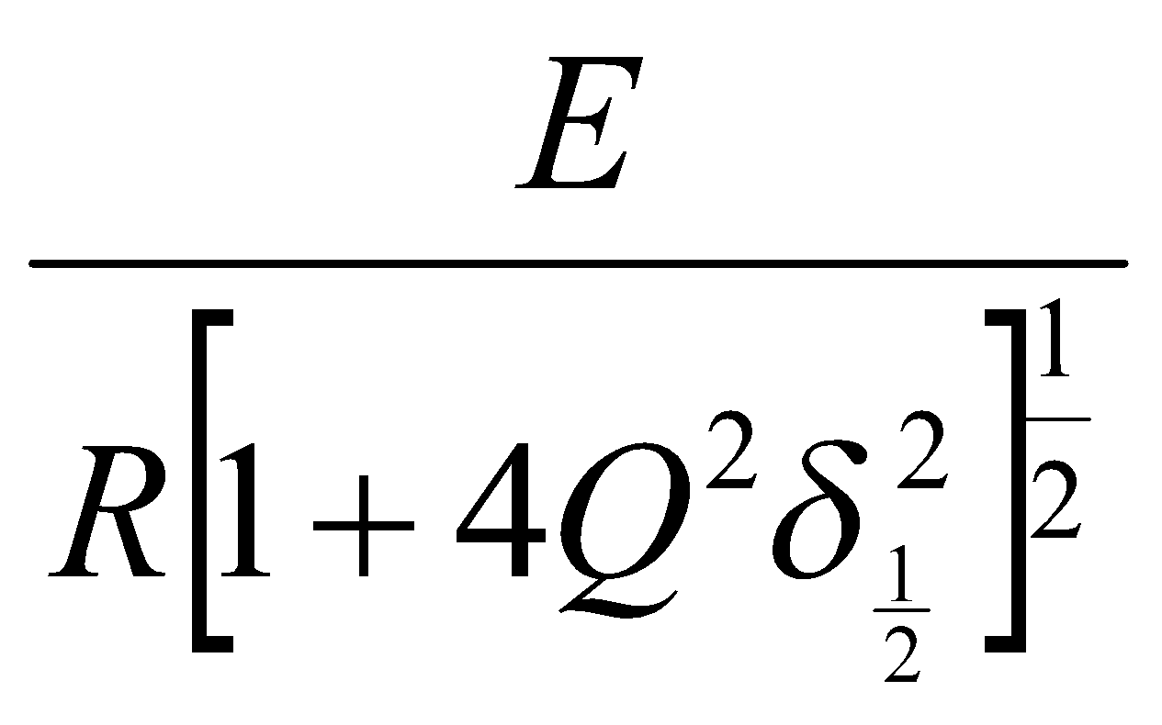
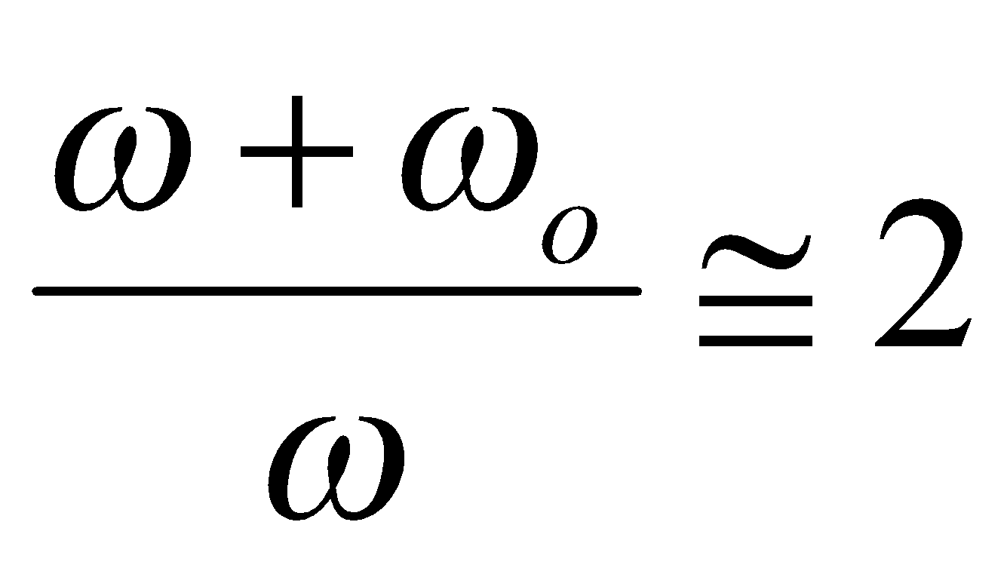
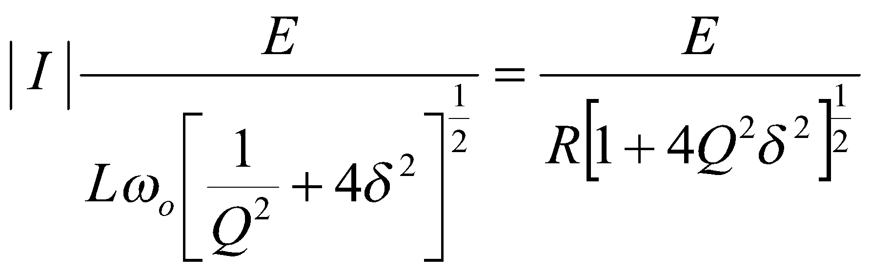

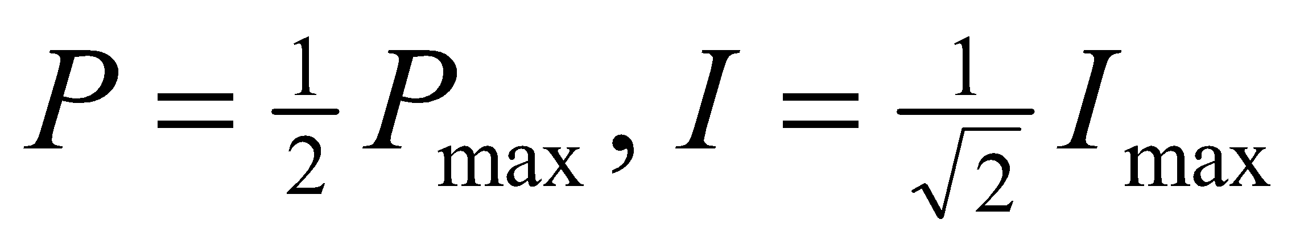
near resonance, if the Q factor is high (as usually is),
ω ≅ ω_{o} and , = δ
| I | is a maximum when δ = 0, giving |I_{max}| =
at the half power points,
i.e. i_{½} = = =

Slide 23
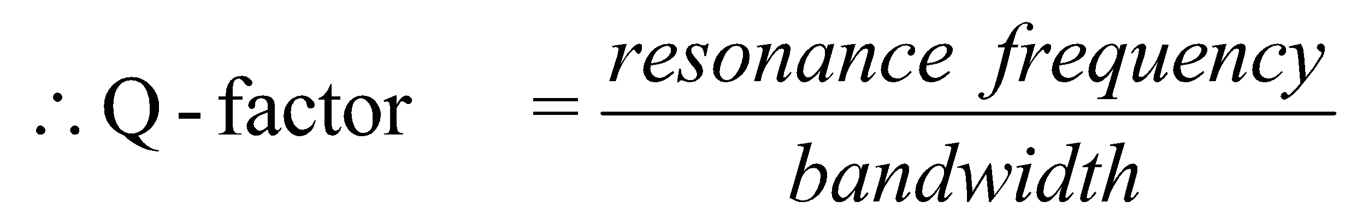
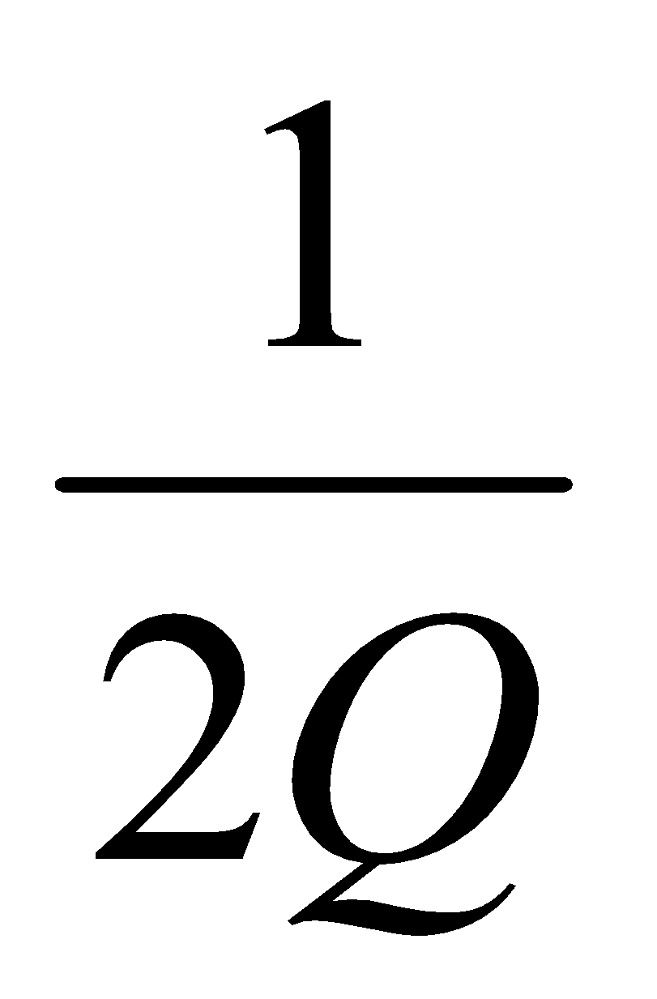
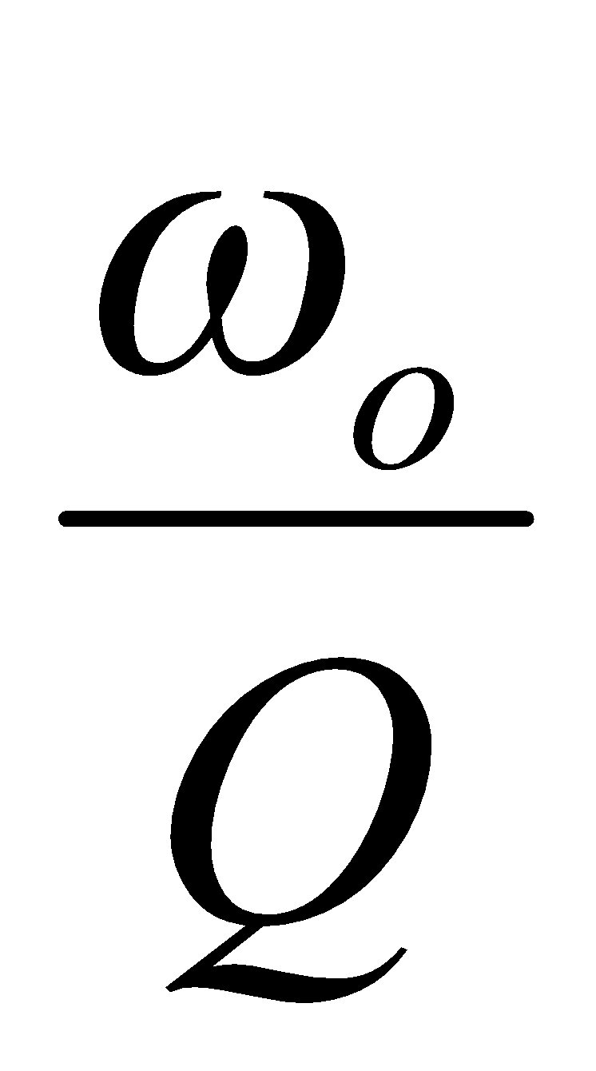
i.e. 1 + 4 Q² δ_{½}² = 2, giving 4 Q² δ_{½}² = 1
∴ δ_{½} = + , δ_{−½} = −
∴ Bandwidth = (ω _{½} − ω_{−½}) = (ω _{½} − ω_{ο}) + ( ω_{ο} − ω_{−½})
= δ_{½} ω_{ο} − δ_{−½} ω_{ο} =
[Same definition can be shown to be true for parallel resonance as well]

Slide 24

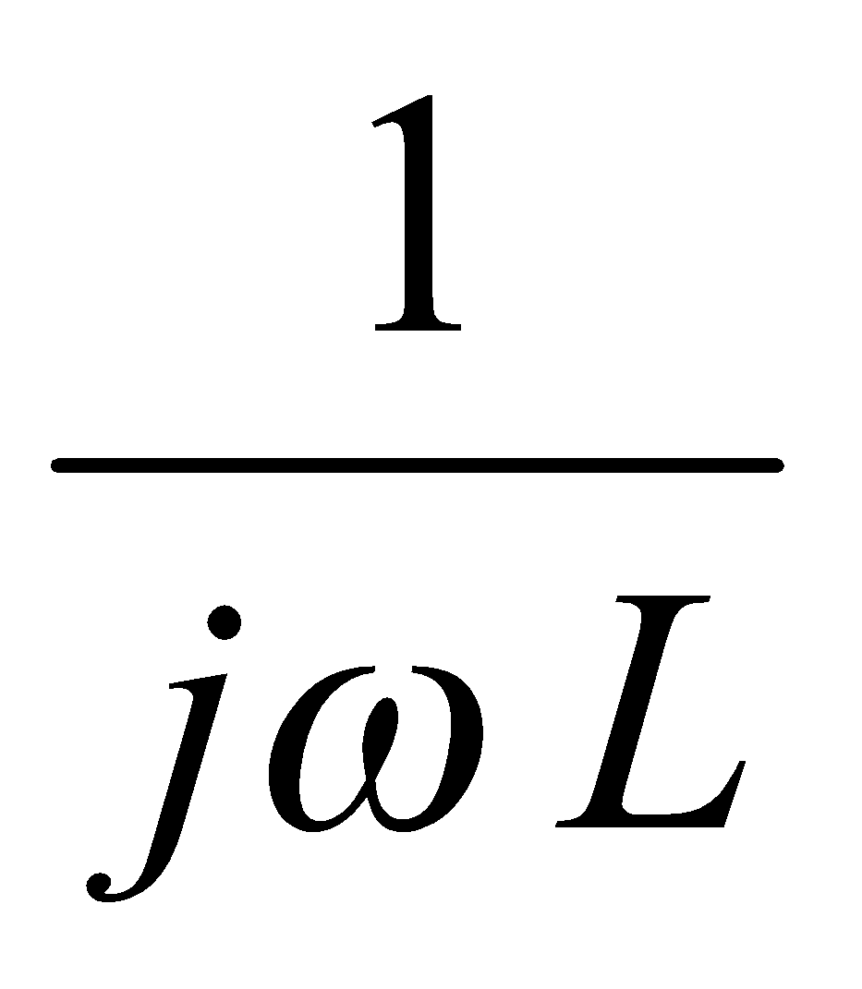
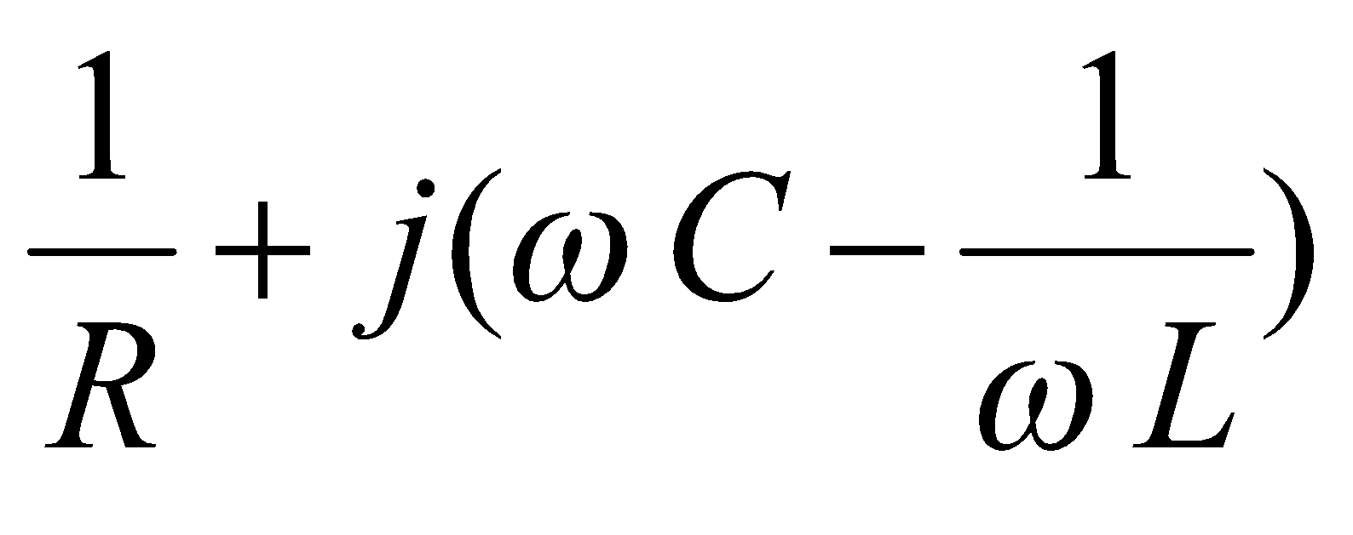
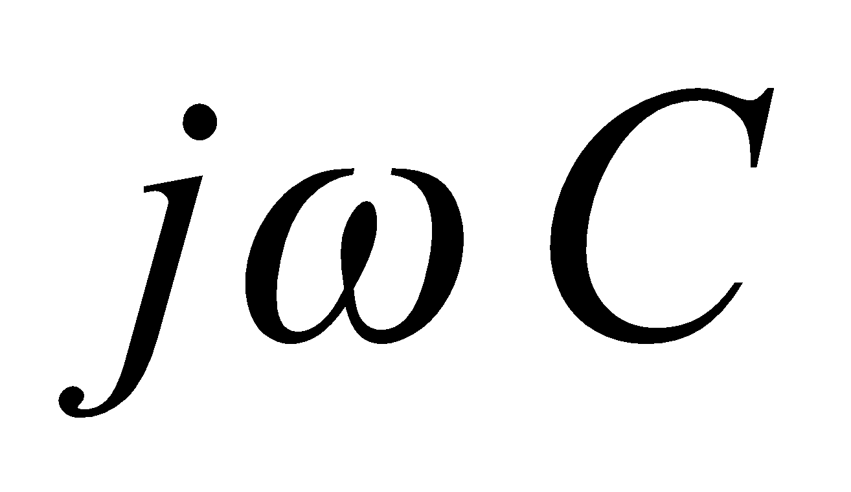
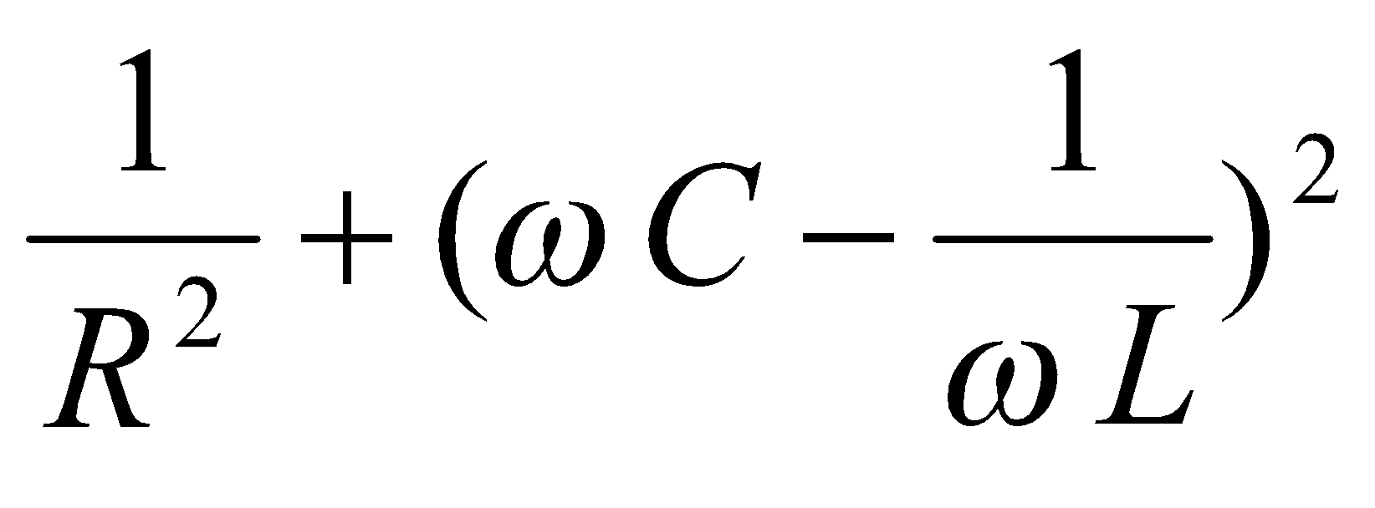
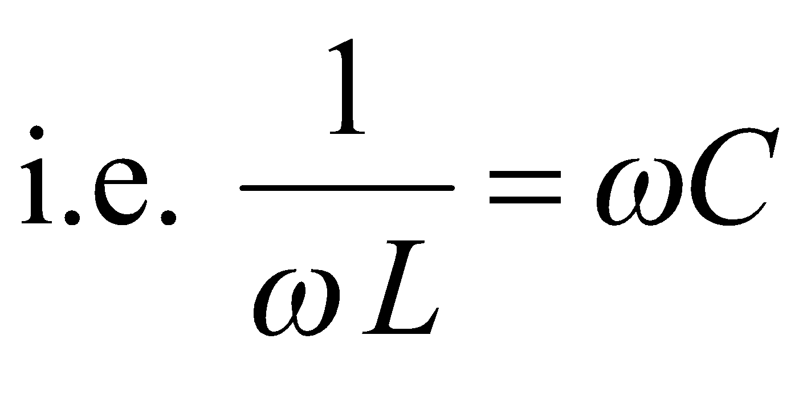
Parallel Resonance
R
Parallel resonance occurs in a circuit where different energy storage elements are connected in parallel.
At an angular frequency of ω,
jωL
Y = + + =
magnitude of admittance = | Y |, | Y |² =
parallel resonance is seen to occur when imaginary part is zero.
Also corresponds to unity power factor.

Slide 25
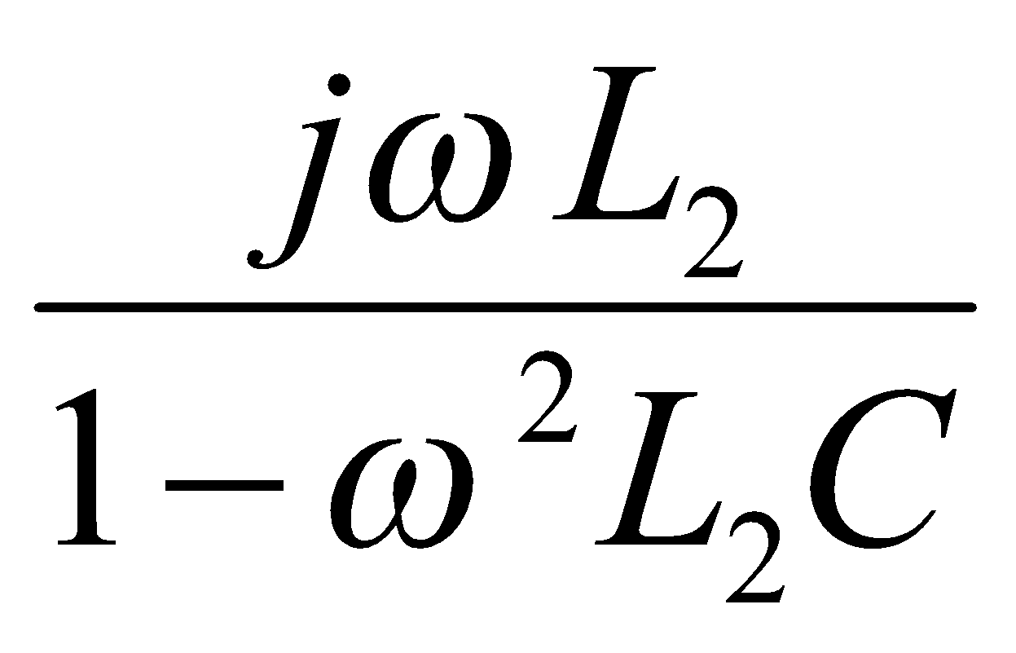
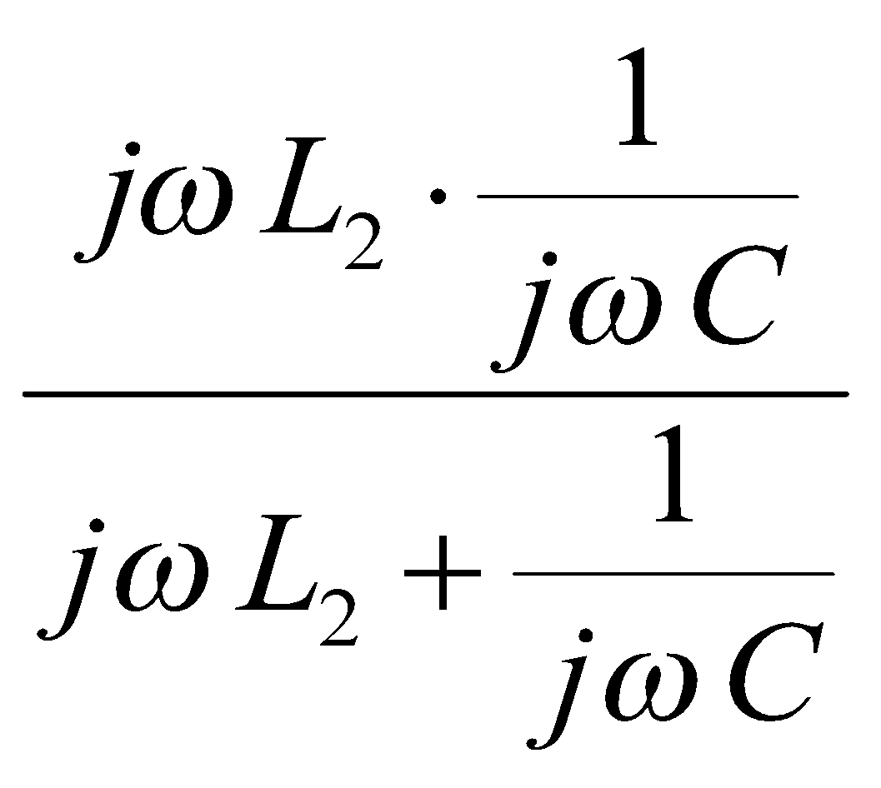
Resonance in Complex Circuits
In practical circuits, series resonance and parallel resonance can occur in different parts of same circuit. Unity power factor resonance may correspond to one of these.
Example 1
L₂
R
L₁
Find the types of resonance and resonance frequencies of the circuit shown.
Solution
C
Z = R + jωL₁ + = R + jωL₁ +

Slide 26
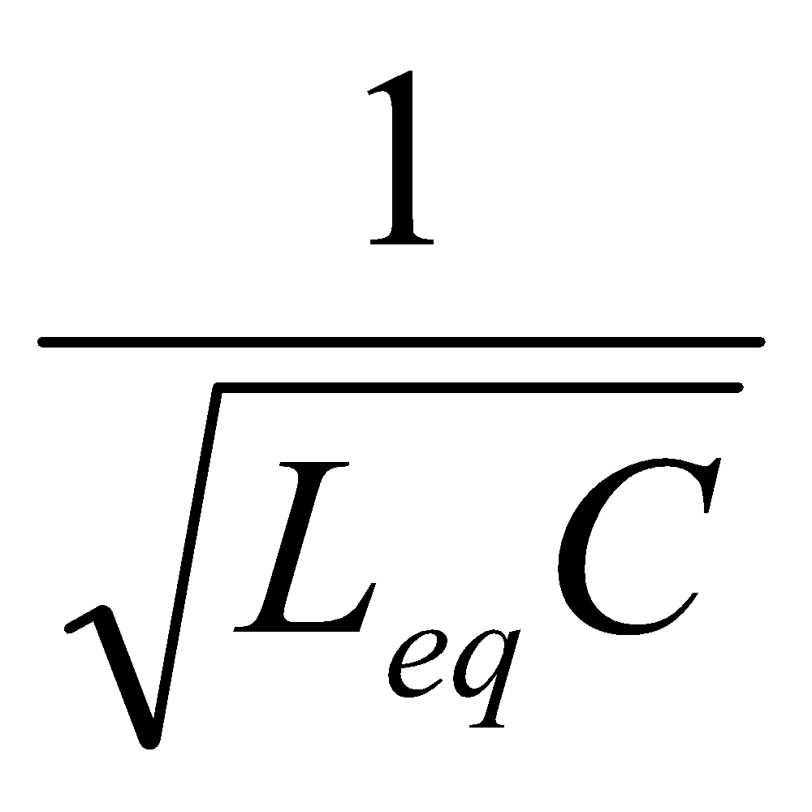
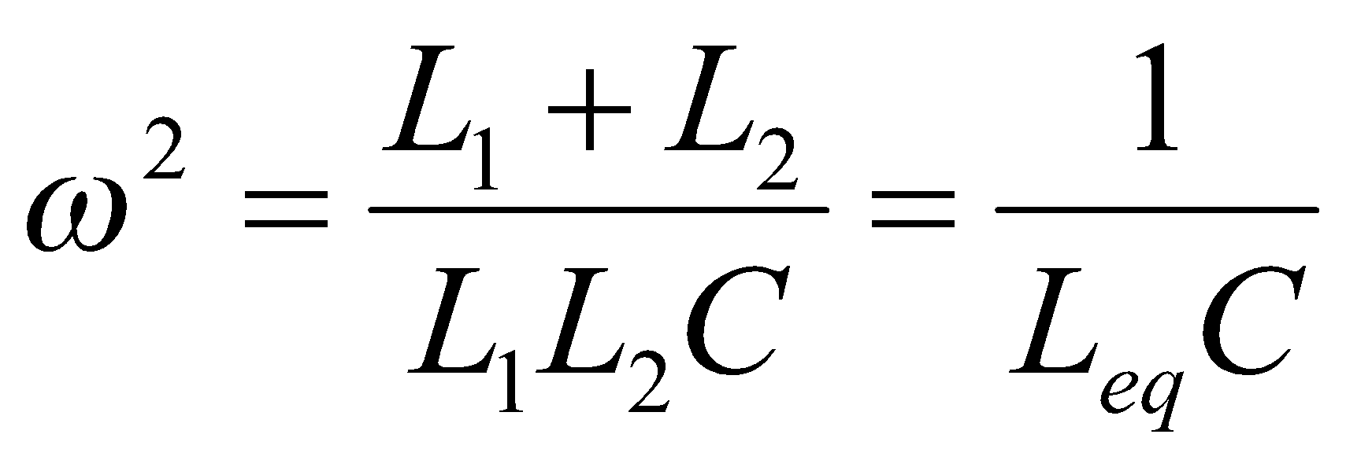


Consider each type of resonance condition in turn
(a) when power factor is unity equivalent impedance is purely real.
Therefore ωL₁ + = 0
i.e. L₁ + L₂ - ω² L₁L₂C = 0, or
where L_{eq} =
It is seen that the equivalent inductance is L₁// L₂.
Thus unity power factor resonance frequency corresponds to ω =

Slide 27


(b) when the impedance of the circuit is a minimum
Examination shows that this also corresponds to a minimum value of impedance, or series resonance.
This need not be the case for all examples.
when the impedance of the circuit is a maximum
| Z |² = R² +
Z will have a maximum value of ∞ at (1 - ω² L₂ C) = 0
∴resonant frequency for parallel resonance =

Slide 28



Example 2
Find unity power factor resonance frequency.
Also determine parallel resonance frequency,
if R = 20 Ω, L = 10 mH, and C = 4 μF.
Solution
Z = =
L
R
C
for unity power factor resonance, impedance Z is purely real
∴
, i.e. C R² = L (1 - w² L C)

Slide 29





ω² =
, or ω =
Unity power factor resonance
ω =
Now consider the magnitude² of the impedance
| Z |² =
for maximum value of | Z |, | Z |² must be a maximum.

Slide 30

Determining condition for Maximum
i.e.
= [(1-ω²LC)² + ω²C²R²].2ωL²
– (R² + ω²L²)[2(1-ω²LC).(− 2ωLC) + 2ωC²R²] = 0
i.e. (1-ω²LC)²L² + ω²C²L²R² + 2R² LC(1-ω²LC)
+ 2 ω²L² LC(1-ω²LC) – (R² + ω²L²)C²R² =0
−ω⁴L⁴ C² + ω² [-2L³C + C²L²R² - 2R² L²C² +2 L³C
– L²C²R²] +L² + 2R² LC - C²R⁴ = 0
substituting values for the components
-0.16×10⁻¹⁸ ω⁴ – 1.28×10⁻¹² ω² + 1.2944×10⁻⁴ = 0
ω⁴ + 8×10⁶ ω² – 0.8090×10¹⁵ = 0

Slide 31
This quadratic equation in ω² can be solved as follows
ω² = −4×10⁶ ± √(16×10¹² + 0.8090×10¹⁵)
= −4×10⁶ ± 28.723×10⁶ = 26.723×10⁶
ω = 4972 rad/s = 791.4 Hz
It can be seen that this resonance frequency is close but not the same as the earlier result of 729.3 Hz.

Slide 32
Loci Diagrams for RL and RC circuits
R
L
I
(a) Series RL circuit
For a constant V at ω,
if R of circuit varies,
V_{R} + V_{L} = V = a constant.
V = (R + j ωL) .I = (R + j X) .I
V, ω
If V is reference, I would lag by φ.
V_{R} is in phase with I,
V_{L} would be quadrature leading I
V_{R} and V_{L} are mutually perpendicular.
When R varies point P moves along semi-circle.
Locus of P is a semicircle.
φ
V_{L}
I
V_{R}
P

Slide 33
Consider variation of I as R varies and X is kept fixed.
V = V_{L} + V_{R}.
V_{L} is first drawn perpendicular to I
Locus of P will again be semi-circle.
Since X is fixed, a definite proportion exists between phasor I and phasor V_{L}
I is always lagging the voltage V_{L} by 90º.
Thus the locus of I must also be a semi-circle lagging the semi-circle for voltage V_{L} by 90º as shown.
V_{L}
P
V_{R}
φ
I

Slide 34
(b) Series RL circuit with inductor L having a finite r
r
L
In practice winding resistance r of inductance, may not be negligible.
V_{X} would have two components
Locus of node between resistor and inductor is no longer a semi-circle. However, locus of total resistance R + r with the pure inductance part remains a semi-circle.
If X is variable, then ratio of V_{R} to V_{r} remains a constant and value of internal resistance of coil can be determined.
I
R
V_{X}
V, ω
V_{X}
V_{L}
I
V_{R}
P
V_{r}

Slide 35
(c) Series RC circuit
Series RC circuit analysed in a similar manner to series RL circuit.
However current would be leading instead of lagging the voltage.
Unlike the practical inductor, practical capacitor does not have significant loss.
Thus the practical locus diagram is same as the theoretical diagram.
I
φ
V_{R}
V_{C}
P
(d) Parallel RL and RC Circuits
Loci diagrams of parallel RL and RC circuits is obtained in a manner similar to obtaining that for the series circuits.

Slide 36

Mutual Inductance
Mutual coupling between coils exist, when one coil is in the magnetic field created by another coil.
L_{p}
L_{s}
φ_{p}
φ_{m}
i_{p}
M
i_{s}
e_{p}
e_{s}
A varying i_{p}(t) in primary winding,
produces varying flux φ_{p} in same coil and back emf e_{p}(t).
Part φ_{m} of flux φ_{p} links with second coil,
with induced emf e_{s}(t).

Slide 37





e_{p} = N_{p}
, e_{s}= N_{s} ,
φ_{m} = k . φ_{p}
l
k – coefficient of coupling
mutual flux φ_{m} ∝ primary flux φ_{p}
k < 1, k ≈ 1 (slightly less but very close to unity).
In the linear region of the magnetisation characteristic,
flux produced φ_{p} ∝ current i_{p} producing the flux.
Also, mutual flux φ_{m} ∝ current i_{p}.
Thus, induced emf e_{s} ∝ rate of change of current i_{p}.
Proportionality Constant defined as Mutual inductance M_{sp}.
N_{p}
N_{s}
A
Toroid
i.e.
, where

Slide 38

Mutual Inductance
Mutual inductance is the flux linkage produced in a secondary winding per unit current in primary winding.
Direction of voltage induced in second coil will depend on the relative direction of winding of the two coils.
Flux φ_{p} is related to the current i_{p} through self inductance L_{p}
May be expressed in terms of the dimensions of the magnetic path (length l and cross-section A) .
l
N_{p}
N_{s}
A

Slide 39




i.e. L_{p} =
but N_{p} i_{p} = H_{p} l
∴ L_{p} =
Mutual inductance may be derived in terms of the dimensions.
M_{sp} =
M_{sp} =

Slide 40






Degree of Coupling
Similarly M_{ps} =
In practice, coupling coefficient k_{ps} = k_{sp}
M_{ps} = M_{sp} = M and a single k is used.
M = ,
L_{p} =
L_{s} =
giving M² = k² L_{p} L_{s}
or M =
or M = k

Slide 41




Energy stored in a pair of mutually coupled coils
.
Inductor stores energy in electromagnetic field =
With mutual coupling, total energy stored by coils is different from addition of terms.
Total energy stored = = ∫ v_{p} i_{p} dt + ∫ v_{s} i_{s} dt
i_{p}
M
i_{s}
V_{p}
V_{s}
L_{p}
L_{s}
= ∫ L_{p} i_{p} di_{p} ± ∫ M i_{p} di_{s} + ∫ L_{s} i_{s} di_{s} ± ∫ M i_{s} di_{p}
Total energy stored = ∫ L_{p}i_{p} di_{p} + ∫ L_{s}i_{s} di_{s} ± ∫ Mi_{p} di_{s} ± ∫ Mi_{s} di_{p}
=
∴ effective energy stored in mutual inductance is ± M i_{p} i_{s} .

Slide 42


Equivalent inductance of 2 mutually coupled coils in series
i
i
L₁
L₂
L₁
L₂
Coils can either be connected in series so that
fluxes aid each other, or fluxes oppose each other.
Since each current is i,
Total energy stored =
or
=

Slide 43




Effective equivalent inductance of series connection
If a single equivalent inductor L_{eq} is considered,
total energy stored =
Thus equating the energies
=
or
i.e. L_{eq} = L₁ + L₂ + 2 M or L₁ + L₂ − 2 M
The effective inductance can either increase or decrease due to mutual coupling dependant on whether the coils are wound in the same direction or not.

Slide 44


Example 3
Consider a couple of coils connected in series as shown.
Let each coil have N turns,
then total series connected coil
has 2N turns.
If the dimensions of the common magnetic circuit on which these are wound have area A and length l
L₁ = L₂ =
I₁
I₂
L₁
L₂
and total coil L =
.L₁ + L₂ is obviously not equal to this total.

Slide 45



What went wrong?
If the two coils are wound on the same magnetic circuit, very closely, then there would be mutual coupling with the coefficient of coupling almost unity.
Then, M = k
≈ 1 ×
Thus the total inductance would be
L₁ + L₂ + 2 M =
as expected.

Slide 46
Magnetic circuit Analysis
When a coil is wound round a magnetic core,
the core becomes magnetised
one side becomes a north pole, and
other side becomes a south pole.
Different methods are there to remember the polarity.
One of the simplest methods is

Slide 47
When we look at a coil from one side,
if current direction is anti-clockwise, nearer side is a north pole (also seen from arrow direction of “N”);
if current direction is clockwise, nearer side is a south pole (also seen from arrow direction of “S”).
left hand side
right hand side
A
B
It can be easily visualised that coil A and coil B are both wound in the same direction.
left hand side
right hand side
A
A
B
B
With slightly differently diagram it would be less obvious.
Thus we use dots to denote similar ends of different coils.

Slide 48
Unity power factor resonance for series circuit
Consider frequency at which power factor becomes unity.
Occurs when imaginary-part(impedance) → 0
or imaginary-part(current) → 0. i.e. j = 0,
or at ω = ω_{o}. (same as before).
Shape of curve is dependant on value of r of the circuit.
As r → 0, perfect resonance occurs, I → ∞ at ω = ω_{o}
As r → 0, angle of current with respect to voltage tends to either π/2 or -π/2, changing at ω = ω_{o}.
Series resistance r defines quality of the resonance.
If r is low, P_{loss} is low and hence the quality is high.
At resonance, low r means r << Lω_{o} and r << 1/Cω_{o}.

Slide 49
Dot Notation
Relative directions of coils is important in determining direction of induced voltage with mutual coupling.
Consider following magnetic circuits, and corresponding electrical circuit with polarities defined by dotted ends.
Although there are two possible ways of drawing the dotted ends, both give same relationship to each other.
Dots do not indicate same polarity but similar ends.
A
B
A
B
A
B

Slide 50
Consider the coil B wound in the opposite direction.
P
Q
R
S
A
B
P
Q
R
S
A
B
Position of dots again indicate the winding directions.
Once dots are drawn to indicate similar ends, there is no necessity to physically place winding in same physical position in the diagram. Thus following diagrams would be identical.
A
B
R
P
Q
R
S
P
Q
S

Slide 51
V₁
V₂
V₁
V₂
I₁
I₂
A
B
I₁
A
I₂
B
With a single coil, the induced voltage would always be opposite to direction of current flow in that winding.
Voltages V₁ and V₂ have been drawn as such. Since each coil is wound in same direction, current I₁ would induce voltages in A and B in the same sense. Same would be the case for I₂.
The fluxes and corresponding induced emfs are thus additive.
In other words, the voltage drop due to the self inductance term and the voltage drop due to the mutual inductance term have the same sign.

Slide 52
If direction of one of the coils were changed but with the currents entering each winding at left hand end.
If the direction of one of the windings is changed, the mutual induced voltage will change in direction relative to the self inductance term.
Thus again the voltage drop due to the self inductance term and the voltage drop due to the mutual inductance term have opposite signs.
The final possibility is if both the direction of winding and the current direction are changed.
V₁
I₂
V₂
V₁
V₂
I₁
I₁
I₂
A
B
A
B

Slide 53
V₁
I₂
V₂
V₁
V₂
I₁
I₂
I₁
A
B
A
B
The voltage drop due to self inductance terms and that due to mutual inductance term must have the same sign.
The derivations were done primarily based on the magnetic circuits appearing in the above 4 cases,
and is similar with the electrical circuits.

Slide 54
Summary of the 4 cases
V₁
V₂
mutual term has
same sign self inductance term
mutual term has
opposite sign to self inductance term
mutual term has
opposite sign to self inductance term
mutual term has
same sign self inductance term
I₁
I₂
A
B
V₁
V₂
I₁
I₂
A
B
V₁
V₂
I₁
I₂
A
B
V₁
V₂
I₁
I₂
A
B

Slide 55
Example 4
For circuit shown, write down voltage drop across AB.
V_{AB} = R. i₁ – e(t) + (L p i₁ + M p i₂) here p = d/dt
V_{BA} = − R. i₁ + e(t) − (L p i₁ + M p i₂)
Since both currents enter at respective dotted ends, mutual inductance term and self inductance term have same sign.
True even if voltage is measured in opposite direction.
e(t)
R
L₁
i₁
A
B
M
L₂
i₂

Slide 56

Mutual inductance with steady state a.c. analysis

Slide 57
Non-coupled Equivalent circuit of simple coupled circuits
When mutual coupling is present,
voltage drops in a particular branch depends on
currents in that branch
currents in other branch with which coupling exists
Series and parallel equivalents of branch circuits containing mutual coupling cannot be easily implemented.
can sometimes be avoided by obtaining a non-coupled equivalent circuit.

Slide 58

(a) Coupled coils being on two arms of a T-junction
Apply Kirchoff’s current law:
mark currents i₁, i₂ and (i₁ – i₂).
Applying Kirchoff’s voltage law
between PR, and RQ,
V_{PR} =
i₁
L₁
M
L₂
i₂
P
i₁− i₂
Q
R
= L₁ p i₁ – M p i₂
or V_{PR} = jωL₁ i₁ – jωM i₂ with sinusoidal current
Current i₁ leaves dotted end of L₁, while current i₂ enters dotted end of L₂,
sign associated with the mutual inductance is negative,
voltage drop term due to mutual inductance has opposite sign to that due to self inductance term
and V_{RQ} = L₂ p i₂ – M p i₁

Slide 59
For a non-coupled equivalent circuit,
voltage drops in a branch should only correspond to it’s own currents.
Re-write the 2 equations as follows to achieve this.
V_{PR} = L₁ p i₁ - M p i₂ – M p i₁ + M p i₁,
i.e. V_{PR} = (L₁ – M) p i₁ + M p (i₁ – i₂)
similarly
V_{RQ} = (L₂ – M) p i₂ + M p (i₁ – i₂)
These two equations would be satisfied with
L_{A} = L₁ – M, L_{B} = L₂ – M, and L_{m} = M
i₁
L_{A}
L_{B}
i₂
P
i₁− i₂
Q
L_{m}
R

Slide 60
Transformation is valid, independent of current directions marked.
[Compare with: Expression for parallel equivalent of two resistors is independent of marking of the current directions when deriving.]
L₁
M
L₂
L₁- M
L₂ - M
≡
M
Note that L – M appears when the two coils are opposing each other.
In this case the common branch has an added +M appearing on it.
In like manner, if the two dots were at the further ends, the equations would be unchanged and the equivalent circuit would also be unchanged.

Slide 61
M
L₁- M
L₂ - M
L₁
L₂
≡
M
If position of one of the dots is changed, then the two coils would be aiding each other, and the terms can be shown to correspond to L+M with a common term of –M.
M
L₁+ M
L₂ + M
L₁
L₂
≡
−M

Slide 62
Example 5
Write down non-coupled equivalent circuit for the coupled circuit.
R₁
L₁
P
R₂
M
E
C
L₂
R₁
L₁
R₂
P
Solution
To get correct sign in non-coupled equivalent circuit, consider imaginary current to flow through coil 1 and coil 2, forgetting other elements.
M
E
C
L₂

Slide 63
It is seen that they are wound opposing. [Notice that the two coils do not exactly meet at a common node, but that the node P would have that property if positions of R₂ and L₂ were interchanged.]
[However, intermediate point of connection between these elements would have a different voltage, as drops are occurring in a different order.]
The non-coupled equivalent circuit may thus be drawn
R₁
L₁-M
R₂
M
E
L₂-M
C
This circuit no longer has mutual coupled elements, but the elements have taken into account the affects of mutual inductance.

Slide 64

Transformer as a pair of mutually coupled coils
Transformer is a pair of mutually coupled coils.
i_{p}
M
i_{s}
From Kirchoff’s voltage law
V_{p} = L_{p} p i_{p} – M p i_{s}
and V_{s} = – (L_{s} p i_{s} – M p i_{p})
For near ideal transformers
|V_{p}| : |V_{s}| ≈ a
|i_{p}| : |i_{s}| ≈ 1/a
Thus
V_{p} and aV_{s} are comparable quantities
i_{p} and i_{s}/a are comparable quantities.
V_{p}
V_{s}
L_{p}
L_{s}
a:1

Slide 65

i_{s}/a
Using these comparable variables
V_{p} = L_{p} p i_{p} – aM p i_{s}/a
and aV_{s} = – (a²L_{s} p i_{s}/a – aM p i_{p})
If i_{p} and i_{s}/a are unequal,
Leakage current = i_{p} – i_{s}/a
re-formulated in terms of this leakage current as
V_{p} = L_{p} p i_{p} – aM p i_{s}/a + aM p i_{p} – aM p i_{p}
= (L_{p} – aM) p i_{p} + aM p .(i_{p} – i_{s}/a)
and aV_{s} = – (a²L_{s} p i_{s}/a – aM p i_{p}) + aM p i_{s}/a – aM p i_{s}/a
= – a² (L_{s} –
i_{p}
i_{s}
i_{p}-i_{s}/a
V_{p}
aV_{s}
V_{s}
a:1
) p i_{s}/a + aM p.(i_{p} – i_{s}/a)

Slide 66


Note that the equations are expressed either in terms of i_{p} and i_{p} – i_{s}/a or in terms of i_{s}/a and i_{p} – i_{s}/a.
Allows a non-coupled equivalent circuit to be formed
i_{p}
l_{p}
a²l_{s}
L_{p}- aM
a²(L_{s} – M/a)
i_{s}/a
i_{s}
V_{p}
i_{p}
i_{s}/a
aV_{s}
V_{p}
≡
aV_{s}
V_{s}
aM
L_{m}
i_{p}-i_{s}/a
i_{p}-i_{s}/a
a:1
May also be drawn with ideal transformer added so that secondary quantities would remain unmodified on that side.
Also, M = k
, L_{p}/L_{s} = a²
so that M = k

Slide 67
giving aM = k L_{p}, L_{p}–aM = (1–k) L_{p},
a²(L_{s} – M/a) = a²(1–k) L_{s}
Since k is the coefficient of coupling,
(1–k) corresponds to the leakage.
(1–k)Lp and (1–k)L_{s} correspond to leakage inductances l_{p} and l_{s} of primary and secondary windings.
Shunt inductance aM corresponds to the magnetisation inductance L_{m} of the transformer.
The transformer equivalent circuit is normally drawn with these variables rather than the self and mutual inductances.

Slide 68
Alternate Analysis
i_{p}
l_{p}
a²l_{s}
i_{p}
M
i_{s}
i_{s}/a
i_{s}
V_{p}
V_{p}
V_{s}
≡
L_{p}
L_{s}
aV_{s}
V_{s}
L_{m}
i_{p}-i_{s}/a
a:1
a:1
V_{p} = jωL_{p} i_{p} – jωM i_{s}
and V_{s} = – (jωL_{s} i_{s}– jωM i_{p})
V_{p} = jωl_{p} i_{p} + jωL_{m} (i_{p} – i_{s}/a)
and aV_{s} = – jω a²l_{s} i_{s}/a + jωL_{m} (i_{p} – i_{s}/a)
V_{p} = jω L_{p} i_{p} – jωaM i_{s}/a
aV_{s}= –(jω a²L_{s} i_{s}/a – jω aM i_{p})
V_{p}= jω(l_{p}+L_{m})i_{p} – jωL_{m} i_{s}/a
aV_{s}= – jω(a²l_{s}+L_{m})i_{s}/a+ jωL_{m}i_{p}
Comparing coefficients of similar terms
l_{p}= L_{p} – aM
L_{m}= aM,
L_{p}=l_{p}+L_{m} ,
aM=L_{m} ,
a²L_{s}=a²l_{s}+L_{m}
→
l_{s}= L_{s} – M/a

Slide 69
Practical Transformer
In addition has
resistances r_{p} and r_{s} in primary and secondary windings
has losses (eddy current loss and hysteresis) in the transformer core based on magnetic flux in core (or on corresponding voltage across windings).
r_{p} , r_{s} are included in primary and secondary sides (r_{s} drawn as a² r_{s}).
Core loss is represented by shunt resistance R_{c} across magnetisation inductance.
i_{p}
l_{p}
r_{p}
a²l_{s}
a²r_{s}
i_{s}/a
a:1
i_{s}
V_{p}
i_{p}-i_{s}/a
aV_{s}
V_{s}
L_{m}
R_{c}

Slide 70
Dependent Sources – Passive Circuit Elements
Most basic elements – R, L and C.
Do not generate any electricity.
Either consume energy
in Resistive elements
convert from electrical form to non-electrical form
produce heat, light etc
or store energy
in Capacitive or Inductive elements
in electrostatic and electromagnetic fields.

Slide 71
Active Circuit Elements (Sources)
Circuit component capable of producing energy.
Categorised into
voltage sources and current sources.
independent sources (generated voltage or current does not depend on any other circuit voltage or current)
dependent sources (generated voltage or current depends on another circuit voltage or current).

Slide 72
Independent Source
Terminal voltage (or current) depends only on the loading and internal source quantity, but not on any other circuit variable.
Symbol for
Independent source
Dependent Source
A dependent voltage source (or current source) would have its terminal voltage (or current) depend on another circuit quantity
such as a voltage or current.
Symbol for
Dependent source

Slide 73
Independent Voltage and Current Sources
e(t)
e(t)
i(t)
Z(p)
i(t)
i(t)
v(t)
v(t)
Figure 5(a) – Ideal voltage source
Figure 5(b) – Practical voltage source
v(t) = e(t) for all i(t) v(t) = e(t) – Z(p).i(t)
I(t)
I(t)
i(t)
Y(p)
v(t)
v(t)
Figure 6(a) – Ideal current source
Figure 6(b) – Practical current source
i(t) = I(t) for all v(t)` i(t) = I(t) – Y(p).v(t)

Slide 74
Dependent Voltage and Current Sources
Four possibilities exist.
αV_{o}
βI_{o}
+ –
+ –
γV_{o}
αI_{o}
Figure 7 – Dependent sources
Voltage dependent (controlled) voltage source
Current dependent (controlled) voltage source
Voltage dependent (controlled) current source
Current dependent (controlled) current source

Slide 75
Example 1
+ –
I
Determine the current I and V_{o}.
4Ω
4V_{o}
Answer
Kirchoff’s voltage law, gives
7.5 = 4 I + 4 V_{o} + 5 – V_{o}
From Ohm’s law
1.I = – V_{o}
By substitution,
I = 2.5 A
V_{o} = – 2.5 V
+
+
5V
–
7.5V
–
1Ω
+
–
V_{o}
Figure 8 – Circuit for example 1

Slide 76
Example 2
Determine I and V_{o}.
Answer
Kirchoff’s voltage law, gives
6 = 5 (I – 0.8V_{o}) – 4 – V_{o}
From Ohm’s law
1.I = – V_{o}
By substitution,
I = 1.0 A
V_{o} = – 1 V
5Ω
I
0.8V_{o}
–
+
6V
4V
+
–
1Ω
+
–
V_{o}
Figure 9 – Circuit for example 2

Slide 77

Example 3
α I
Determine the current I.
Answer
R₁
I
Kirchoff’s voltage law, gives
E = R₁ I + R₂ (1+α) I
From Ohm’s law
R_{o} αI = – V_{o}
By solution of equations
+
+
E
R_{o}
V_{o}
–
R₂
–
Figure 10 – Circuit for example 3

Slide 78

Operational Amplifier (Op Amp)
an active circuit element
behaves as a voltage-controlled voltage source
very versatile
can be used to add, subtract, multiply, divide, amplify, integrate and differentiate signals.
Practical Op Amp available in Integrated circuit (IC) packages

Slide 79
Op Amp has inputs and outputs as shown in figure 11.
Output voltage is limited to the linear range V⁺ to V–.
Ouside these limits, Op Amp is said to be saturated.
‘Null’ determines the offset.
V⁺
Inverting Input
–
Output
+
Non-inverting Input
V⁻
Null
Figure 11 – Circuit connections of Op Amp

Slide 80
Op Amp equivalent Circuit
–
V_{d} – Voltage difference of input terminals + and –
A – Gain of Op Amp
R_{in} – Input resistance of Op Amp
R_{out} – Output resistance of Op Amp
R_{out}
V_{out}
V_{d}
R_{in}
+
–
A V_{d}
Figure 12 – Equivalent Circuit of Op Amp
V_{out} linearly proportional to V_{d} with open-loop gain A.
Op Amp has a dependent voltage source AV_{d.}

Slide 81
Parameters of Ideal Op Amp
Parameter | Symbol | Ideal | Typical
Open-loop gain | A | ∞ | 10⁵ to 10⁸
Input Resistance | R_{in} | ∞ | 10⁶ to 10¹³ Ω
Output Resistance | R_{out} | 0 | 10 to 100 Ω
Supply Voltage | V⁺, V– |  | 5 to 24 V

Slide 82
Inverting Amplifier
An inverting amplifier circuit is shown in figure 13.
R₂
R₁
V⁺
–
+
V_{in}
V_{out}
V⁻
Figure 13 – Circuit of Inverting Amplifier
In an inverting amplifier output voltage is a negated and amplified input voltage.

Slide 83


Derivation for Inverting Amplifier form first principles
R₂
i
R₁
–
R_{out}
V_{d}
R_{in}
+
–
Figure 14 shows equivalent circuit of inverting amplifier.
If R_{out} = 0, and R_{in} = ∞,
V_{out} = – A V_{d}
+
– A V_{d}
V_{out}
Figure14 – Equivalent Circuit

Slide 84




giving
Thus
–
V_{out}
R_{in} =∞
R_{out}=0
If A → ∞ as for an ideal Op Amp,
Gain =
V_{d}
+
A V_{d}
–
,
+
Thus V_{d} is taken as virtual earth, when analyzing.

Slide 85

Non-inverting Amplifier
V⁺
Input voltage is applied directly to non-inverting (+) input and a small part of output voltage is applied to the inverting (–) input from the R₁ R₂ potential divider.
For an ideal Op Amp,
with R_{out} = 0, R_{in} = ∞ and A = ∞
Gain =
V_{in}
–
V_{out}
+
V⁻
R₂
R₁
Figure 15 – Non-inverting Amplifier

Slide 86


Summing Amplifier
R₂
With 2 inputs, Summing amplifier is obtained.
V_{inA}
R_{1A}
With R_{1A} = R_{1B}
V⁺
R_{1B}
–
V_{inB}
+
V_{out}
V⁻
If R_{1A} ≠ R_{1B}
Figure 16 – Summing Amplifier

Slide 87


Differential Amplifier
R₂
Inputs are connected to both inverting or non-inverting terminals
Resultant output based on difference between V_{1A} and V_{1B}
I_{A}
R_{1A}
V⁺
V_{inA}
–
R_{1B}
V_{d}
I_{B}
V_{inB}
+
V_{out}
R₃
V⁻
For ideal Op Amp,
R_{in} = ∞, R_{out} = 0, and A = ∞.
Figure 17 – Differential Amplifier
giving

Slide 88






,
This gives
Substitution gives
When R_{1A} = R_{1B} = R₁ and R₃ = R₂,

Slide 89


Integrating Op Amp
i₂
C₂
i₁
R₁
V_{in}
–
V_{d}
V_{out}
+
0
Figure 14 – Circuit of Integrating Op Amp
Considering V_{d} to be virtual zero and i₂ = i₁

